Slide 1

Faith Perspectives on Vaccines
Notes:
Living out our faith shapes our world views and influences our decisions. As people of faith, we want to live in a way that honors God and aligns with our beliefs. This module intends to help families answer the question of how we can understand the importance of vaccines in the context of faith.

Slide 2
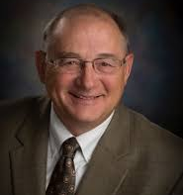
Words of Wisdom
"I believe that we are now at a crossroads in our American Culture. We can either choose to follow the ‘culture of me’ (and only my rights) or the ‘culture of we’ (and the greater good for all).
For me, I choose ‘to love my neighbor as myself’ and get vaccinated with a safe effective immunization that does just that—protects me and everyone around me.
This is an ultimate expression of our Christian faith, as we strive to protect all of us. Protect yourself AND EVERYONE ELSE.
Get vaccinated as soon as you can!!"
Dr. John Eplee
Representative for Kansas District 63
Kansas Family Physician of the Year, 2019

Slide 3
3 Main Purposes of Vaccination

Slide 4
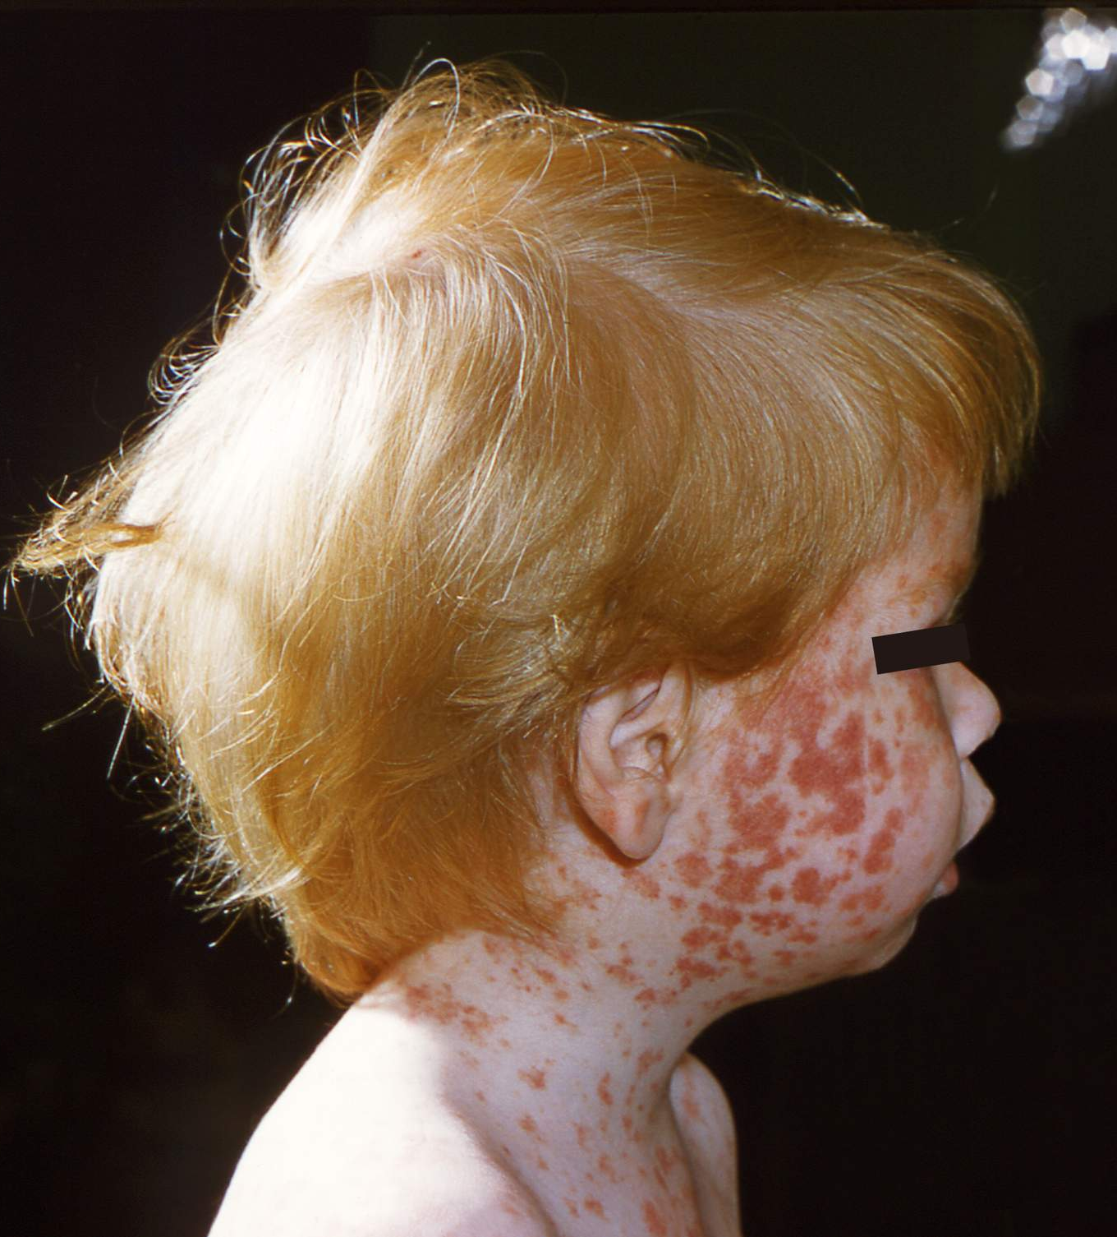
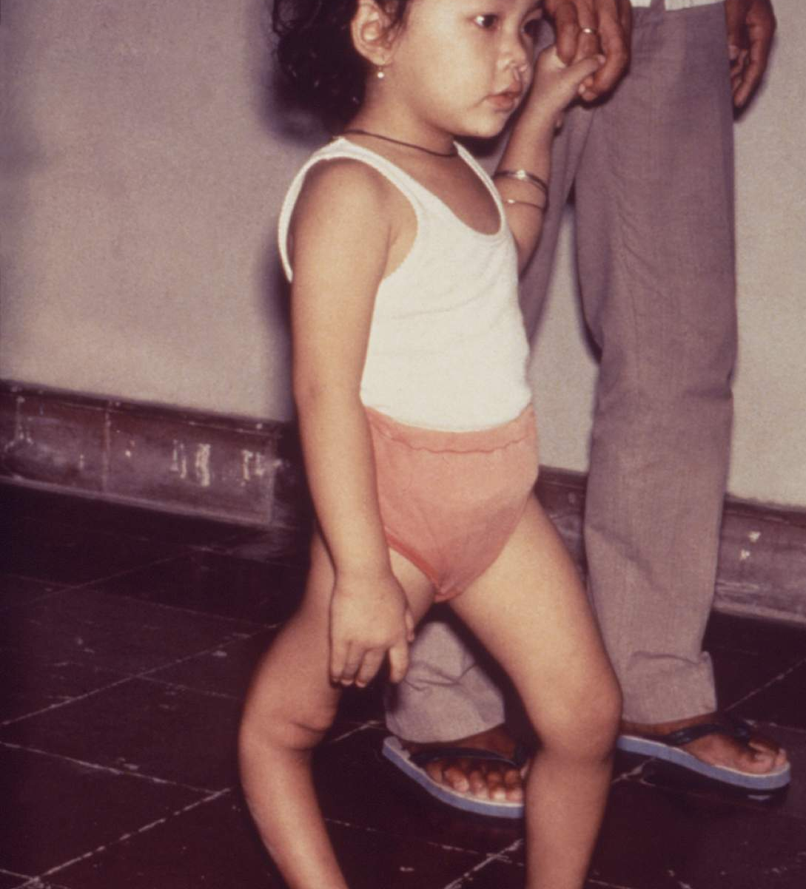
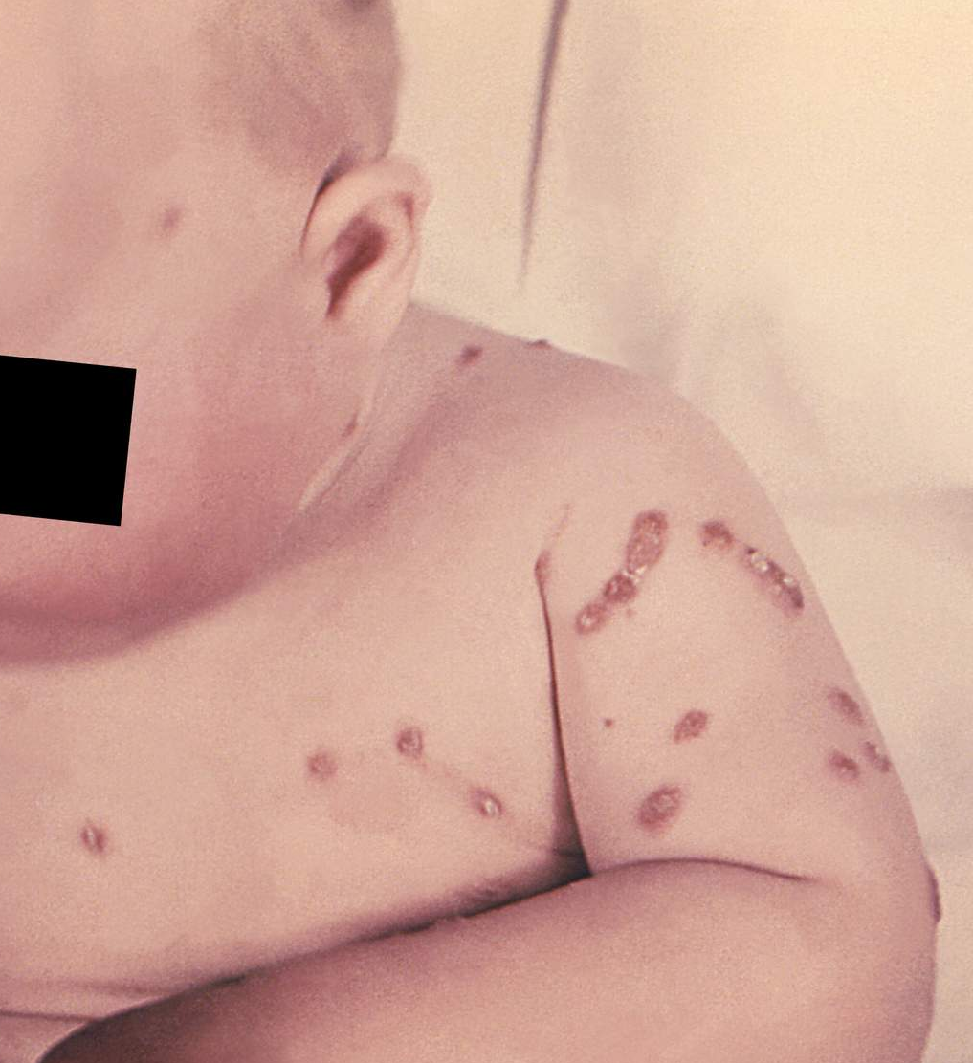
#1 Vaccines help protect the health and life of those who get vaccinated.

Slide 5
#1 Vaccines help protect the health and life of those who get vaccinated.
After 2 doses of the MMR vaccines, 99.7% of vaccinated individuals are immune to measles

Slide 6
#1 Vaccines help protect the health and life of those who get vaccinated.
After 2 doses of the MMR vaccines, 99.7% of vaccinated individuals are immune to measles
Polio vaccine offers 99% effectiveness after 3 doses

Slide 7
#1 Vaccines help protect the health and life of those who get vaccinated.
After 2 doses of the MMR vaccines, 99.7% of vaccinated individuals are immune to measles
Polio vaccine offers 99% effectiveness after 3 doses
Chickenpox vaccine is 85% to 90% effective in preventing all chickenpox infections and 100% effective in preventing moderate and severe chicken pox.

Slide 8
#1 Vaccines help protect the health and life of those who get vaccinated.
Often, the diseases prevented by vaccines are severe, requiring hospital care.
For example, in the U.S. in 2011, 222 people had measles and 1 out of 3 needed hospital care.
These diseases also may lead to long-term disability.
For example, after meningitis caused by infection with the pneumococcus bacteria, people often have:
  Nerve damage that interferes with daily life
  Hearing loss
  Long-term learning and thinking problems
Notes:
Often, the diseases prevented by vaccines are severe, requiring hospital care. For example, in the U.S. in 2011, 222 people had measles and 1-out-of-3 needed hospital care.
These diseases also may lead to long-term disability. For example, after meningitis caused by infection with the bacteria called pneumococcus (which is usually prevented by vaccination), people often have:
Nerve damage that interferes with daily life
Hearing loss
Long-term learning and thinking problems

Slide 9

#2 Vaccines help our friends and families – of all ages - to safely gather.
Babies
Some illnesses, such as pertussis (whooping cough) are very dangerous to infants. Anyone in close contact with an infant should be sure they are fully vaccinated.
Notes:
Babies
Some illnesses, such as pertussis (whooping cough) are very dangerous to infants. Anyone in close contact with an infant (for example, siblings, parents, visitors, care takers) should be sure they are fully vaccinated.

Slide 10
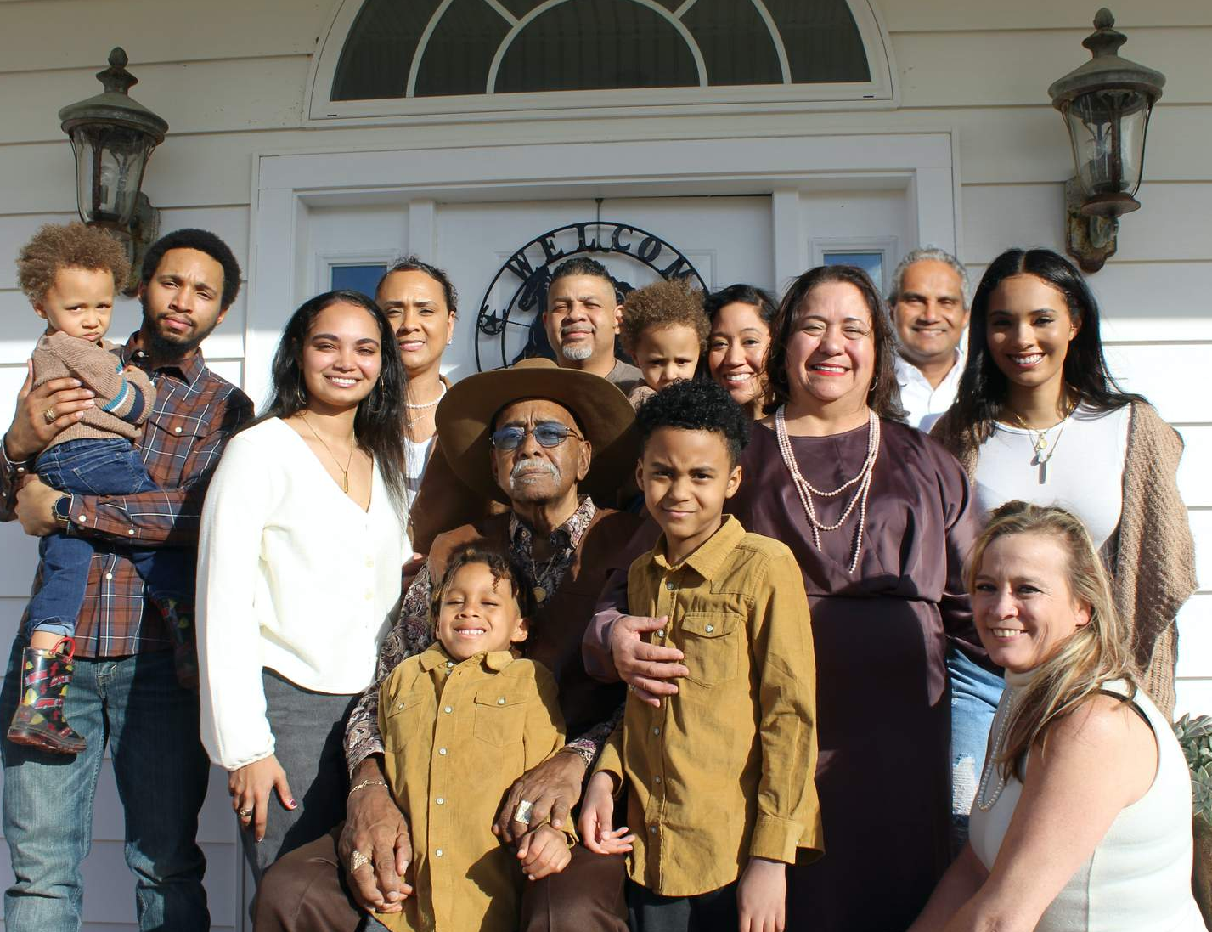
#2 Vaccines help our friends and families –of all ages - to safely gather.
Families and Friends
Vaccines help us prevent spread of infections to our families and others near us.
Keep in mind -- we don’t always know the medical history of the person next to us during work, play, or worship.
Notes:
Families and Friends
Vaccines help us prevent spread of infections to our families and others near us.
Keep in mind -- we don't know the medical history of the person next to us during work, play, or worship. They may not be able to fight off a serious infection.

Slide 11
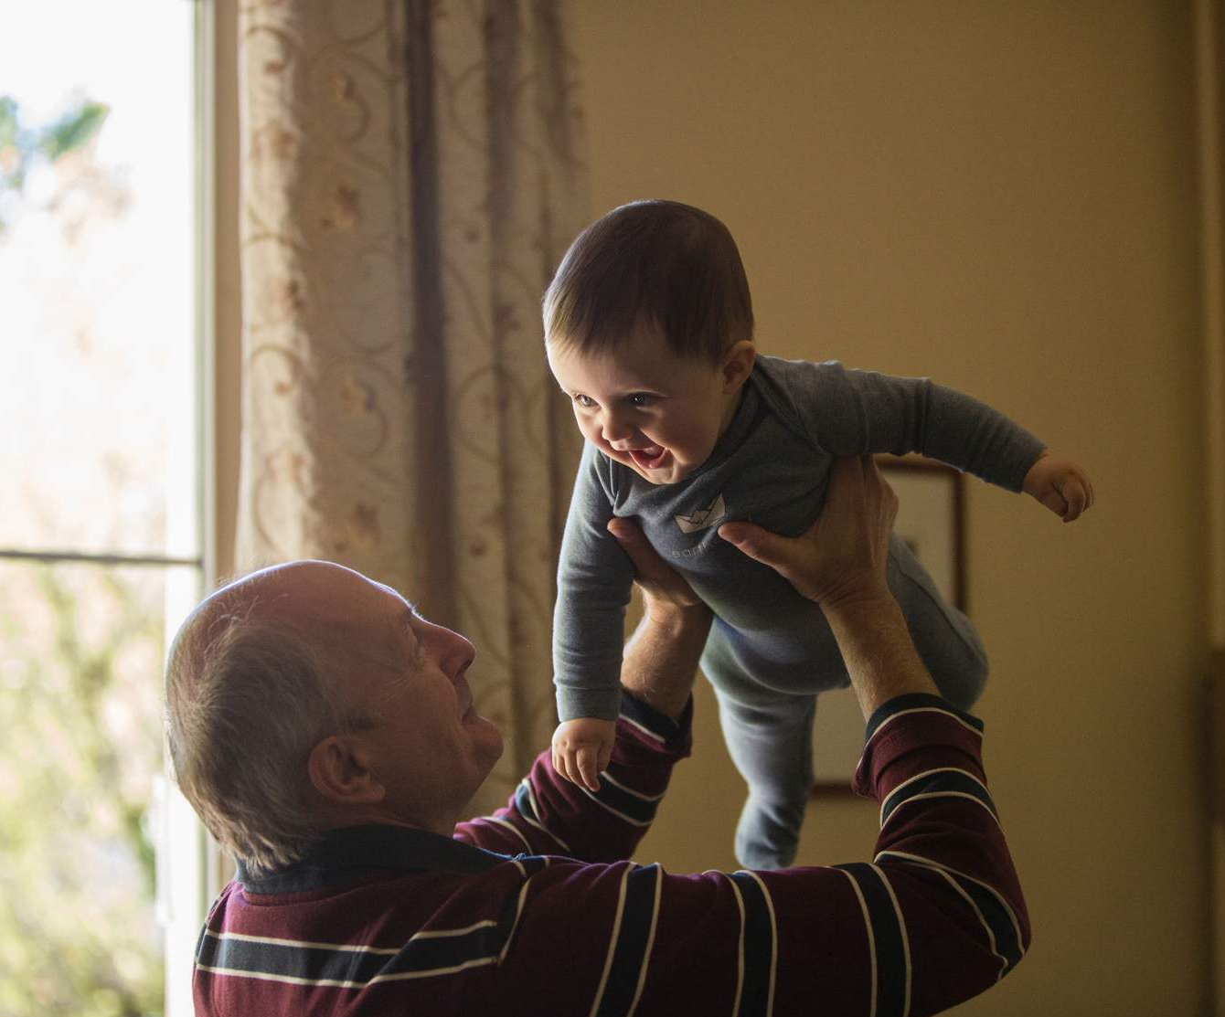
#2 Vaccines help our friends and families –of all ages - to safely gather.
Elders
Some infections, like flu, can take a big toll on people ages 65 and older.
If the people around them get vaccinated, that reduces their risk of exposure.
Notes:
Elders
Some infections, for example flu, take a big toll on people ages 65 and older.
Even after a grandparent gets the flu vaccine, their immune system may not be strong enough to fight off the virus 100% 0f the time. If the people around them (including children) get the vaccine, that reduces their risk of exposure.

Slide 12
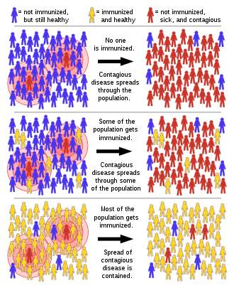
#3 Vaccines help keep our neighbors and communities safer.
Community immunity: the protection offered to everyone in a community by high vaccination rates.
This offers some protection to people who are unable to receive vaccinations.
Notes:
Community immunity: the protection offered to everyone in a community by high vaccination rates. When enough people are immunized against a given disease, it’s difficult for the disease to spread in the community.
This offers some protection to people who are unable to receive vaccinations—including newborns and those with certain cancers or autoimmune disease—by reducing the likelihood they'll be exposed to the disease.
Top box: This shows an outbreak in a community in which a few people are infected (shown in red) and the rest are healthy but not immunized (shown in blue); the illness spreads freely through the population.
Middle box: This shows a population where a small number have been immunized (shown in yellow). Those not immunized become infected while those immunized do not.
Bottom box: In this case, a large proportion of the population have been immunized. This prevents the illness from spreading much, including to not immunized people.
In the first two examples, most healthy not immunized people become infected, whereas in the bottom example only one fourth of the healthy not immunized people become infected.

Slide 13


We can love our neighbors by getting vaccinated.
"...the morality of vaccination depends not only on the duty to protect one's own health, but also on the duty to pursue the common good"
from The Vatican Statement

Slide 14
"If God wants to take me, then He will take me."
Some people say this as a reason to avoid vaccination.
Have you ever heard someone say this?
Notes:
Some people say this as a reason to avoid vaccination.
Have you ever heard someone say they did not want a vaccine because,
“If God wants to take me, then He will take me.”?

Slide 15

“If God wants to take me, then he will take me.”
God created everything - including our bodies! He designed our bodies with natural immune systems, but in our fallen world we encounter disease and infection that can be too much for our bodies.
But God also created our incredible brains! Researchers and scientists have used their brains to understand the immune system and develop vaccines that work with our natural immune system “equipping it to do the extraordinary work God created it to do. Like a military drill, vaccination ensures our defenses are fully prepared to fend off a dangerous disease.”
Quotation from Biologos
Notes:
God created everything, including our bodies! He designed our bodies with natural immune systems, but in our fallen world we encounter disease and infection that can be too much for our bodies.
God also created our incredible brains! Researchers and scientists have used their brains to understand the immune system and develop vaccines that work with our natural immune system “equipping it to do the extraordinary work God created it to do. Like a military drill, vaccination ensures our defenses are fully prepared to fend off a dangerous disease.”

Slide 16
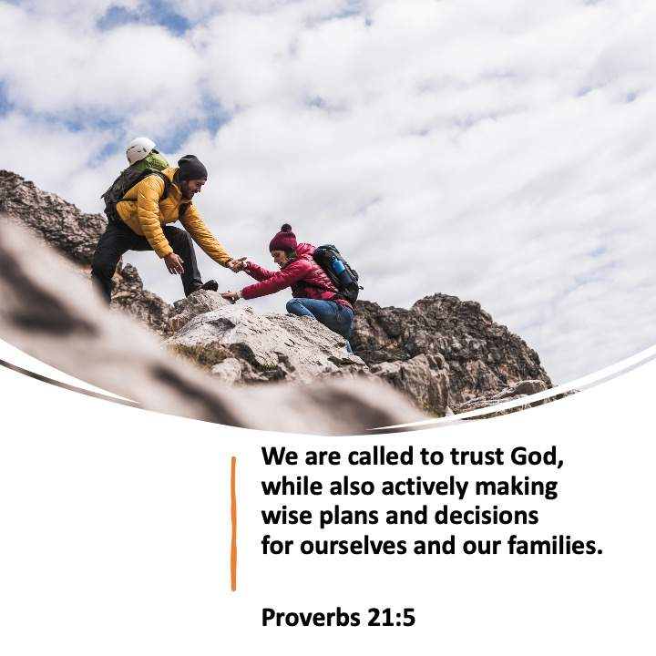
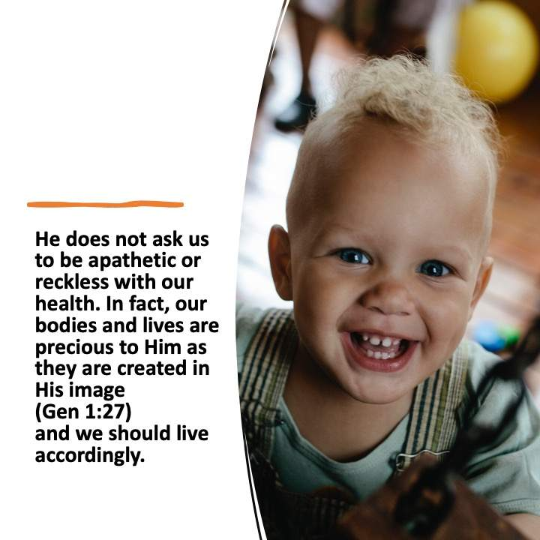

Slide 17

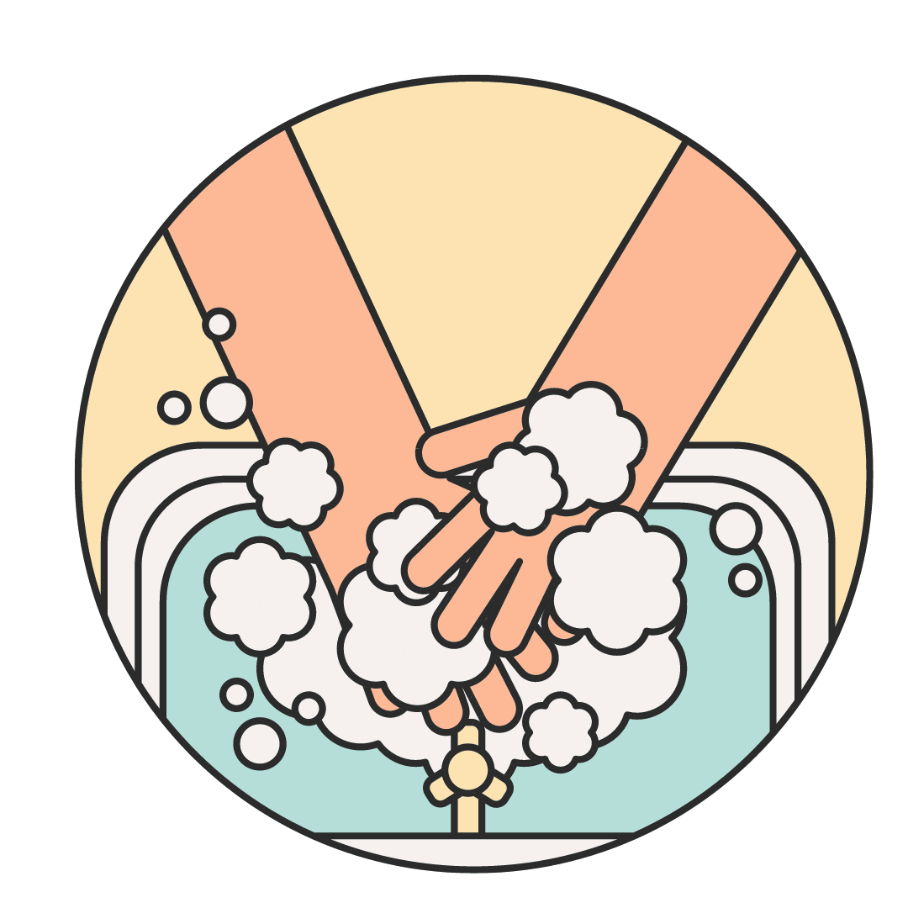


Vaccines are the safest option
We do plenty of common-sense things to minimize risk to protect our health and the health of our families, like:
  washing hands before meals
  cooking meat to the proper temperature
  stopping at stop signs
  ensuring children do not run into the street
Notes:
While no vaccine (or medicine) is without some risk, vaccines are proven to be the exceedingly safer option when compared with the risks of contracting vaccine-preventable diseases. We can make the decision to get vaccinated because we highly value and want to wisely protect our bodies and lives – and those over others.

Slide 18


Slide 19
"Can I trust doctors, scientists, and others?"

Slide 20

Proverbs 3:7-8
"Do not be wise in your own eyes; fear the Lord and shun evil. This will bring health to your body and nourishment to your bones."
Notes:
In humility, we can wisely choose to trust expert scientists and researchers with the development of vaccines and doctors recommendations for which vaccines to receive.
Instead of being “wise in our own eyes” about topics like virology and epidemiology - that admittedly most of us know very little about! - we can trust people God has placed in our lives who have studied these areas and are best equipped to make recommendations for our health.

Slide 21


Proverbs 3:7-8
In humility, we can trust the scientists, researchers, and doctors who have studied these topics and are best equipped to make these recommendations.
Notes:
In humility, we can wisely choose to trust expert scientists and researchers with the development of vaccines and doctors recommendations for which vaccines to receive.
Instead of being “wise in our own eyes” about topics like virology and epidemiology - that admittedly most of us know very little about! - we can trust people God has placed in our lives who have studied these areas and are best equipped to make recommendations for our health.

Slide 22
History of Faiths and Vaccination
Notes:
Here we offer a few examples of how faith communities have supported vaccination.

Slide 23
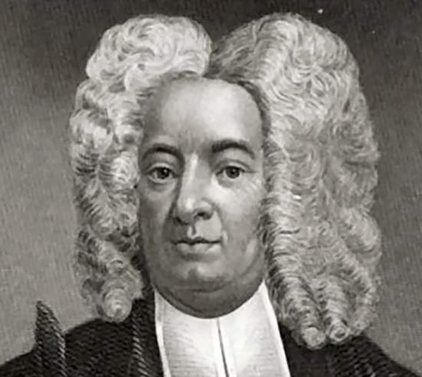
Long Support
“Christians have quietly been part of the immunization success story for years, and faith communities already play an important role in reaching the underserved with vaccines. It's time to speak up to dispel myths that vaccines are harmful, and in support of continued U.S. support for immunization programs. No child should have to die of a disease we can prevent.”
From Christians' Long Support for Vaccines
Image of Cotton Mather
Notes:
From Christians' Long Support for Vaccines
Available at https://www.christiancentury.org/blogs/archive/2014-10/christians-long-support-vaccines

Slide 24
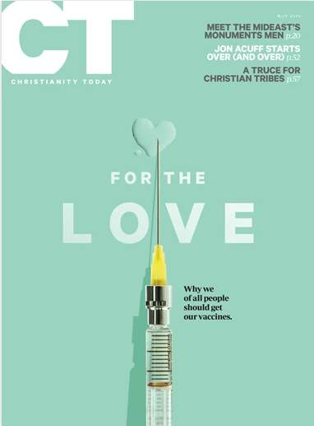
Pro-Vaccines History
“The first public 'vaccines' campaign in US history was led by a Puritan preacher.
Cotton Mather had seen smallpox kill many fellow Bostonians, including his first wife and several of his children. The disease was a scourge on Native Americans and colonists living in New England in the 17th and 18th centuries. But Mather knew disease wasn’t inevitable. He had studied the sciences at Harvard before taking over his father’s influential congregation, Boston’s North Church. He believed God revealed truth in the book of Scripture and the book of nature, and Mather published several works showing the harmony between the two.”
From Christians' Pro-Vaccines History
Notes:
From Christians' Pro-Vaccines History(opens in a new tab)
Available at https://www.christianitytoday.com/ct/2015/may/christians-pro-vaccines-history.html

Slide 25
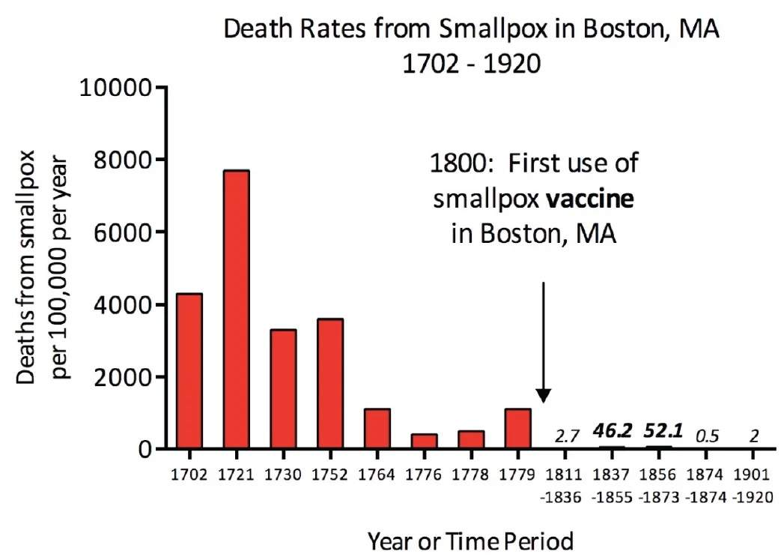
Smallpox Epidemic
"On a November day in 1721, a small bomb was hurled through the window of a local Boston Reverend named Cotton Mather. Attached to the explosive, which fortunately did not detonate, was the message: “Cotton Mather, you dog, dam you! I’ll inoculate you with this; with a pox to you.’’ This was not a religiously motivated act of terrorism, but a violent response to Reverend Mather’s active promotion of smallpox inoculation.”

Slide 26
Smallpox Epidemic
“The smallpox epidemic that struck Boston in 1721 was one of the most deadly of the century in colonial America, but was also the catalyst for the first major application of preventative inoculation in the colonies. The use of inoculation laid the foundation for the modern techniques of infectious diseases prevention, and the contentious public debate that accompanied the introduction of this poorly understood medical technology has surprising similarities to contemporary misunderstandings over vaccination.”
From The Fight Over Inoculation During the 1721 Boston Smallpox Epidemic

Slide 27
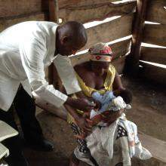
Churches Respond
Around the world, churches help their communities get vaccinated and put an end to vaccine-preventable diseases like polio and measles for children and adults.​
For an interesting look at how the church responded to previous pandemics, read this article from the Canadian Centre for Christian Charities
Available at https://www.cccc.org/news_blogs/john/2021/01/11/how-the-church-responded-to-previous-pandemics/
A health worker vaccinates a baby at Bishop Masereka Medical Center in Uganda. (Christian Connections for International Health)
Notes:
Around the world, churches help their communities get vaccinated and put an end to vaccine-preventable diseases like polio and measles for children and adults.
In this picture to the right, a health worker vaccinates a baby at Bishop Masereka Medical Center in Uganda

Slide 28
What diseases do vaccines prevent?
Ages birth to 6 years

Slide 29
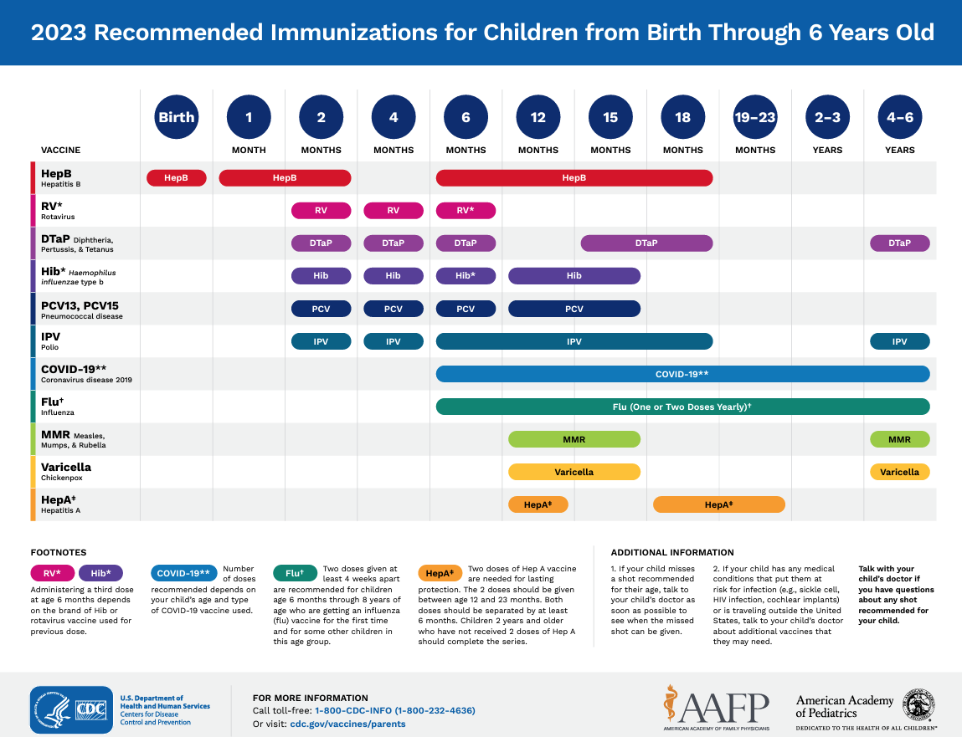

Birth to 6 Years Immunization Schedule
Why do we want to prevent these diseases?
Click on the schedule to open the full PDF in web browser.
Notes:
View as PDF online: https://www.cdc.gov/vaccines/parents/downloads/parent-ver-sch-0-6yrs.pdf

Slide 30
Hepatitis B
A virus that can destroy the liver
Spread: Through contact with blood, saliva, body tissues, or the fluids of an infected person.
Vaccine reactions: If any, tend to be mild, such as soreness at the injection site or slight fever.​
The first dose: This should be given in the delivery center because any exposure to hepatitis B in the newborn period is a medical emergency.​
Notes:
Spread: through contact with blood, saliva, body tissues, or the fluids of an infected person. Many people who contract hepatitis B never find out how they became infected.
Disease: Hepatitis B damages the liver
Infants are at special risk because if they become infect from their mothers at birth or during infancy: 90% will develop a life-long hepatitis B infection and 25% of those with this long-term infection will develop liver cancer of liver failure later in life.
Vaccine reactions: if any, tend to be mild, such as soreness at the injection site or slight fever.
The first dose: this should be given in the delivery center because any exposure to hepatitis B in the newborn period is a medical emergency.
Many adults need hepatitis B vaccine, too, because they did not get it when they were children.

Slide 31
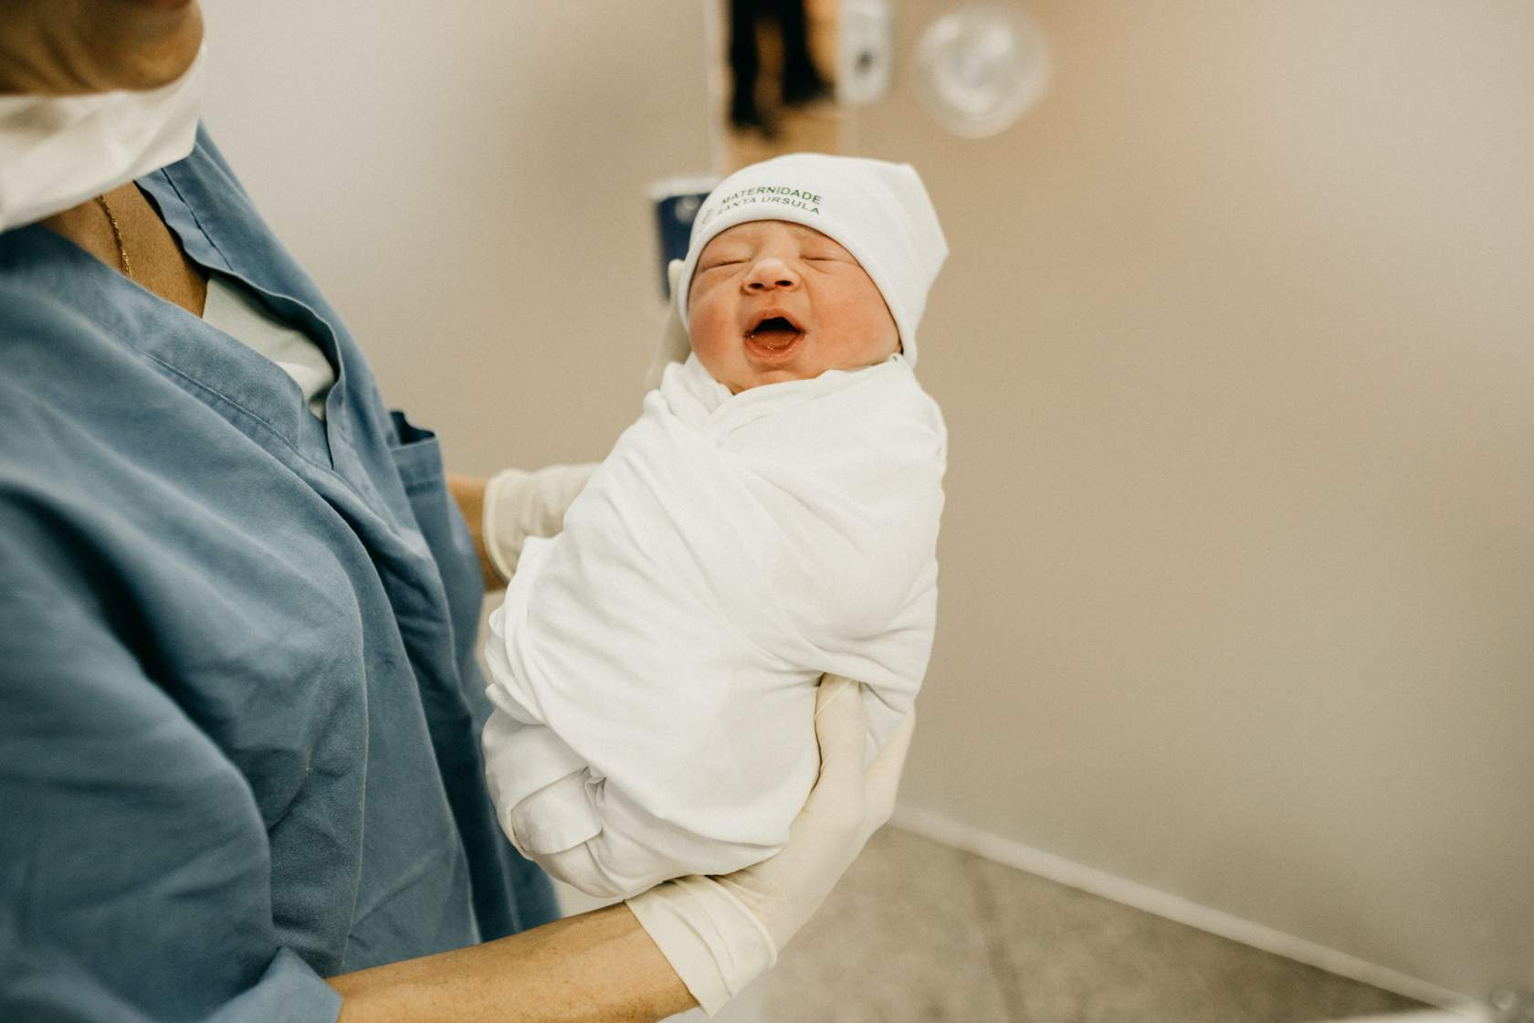

Hepatitis B
A virus that can destroy the liver
Infants are at special risk because if they become infected from their mothers at birth or during infancy:
90% will develop a life-long hepatitis B infection
25% of those with this long-term infection will develop liver cancer or liver failure later in life.
Many adults need hepatitis B vaccine, too, because they did not get it when they were children.
If you are not sure whether you’ve been vaccinated, check with your doctor!

Slide 32
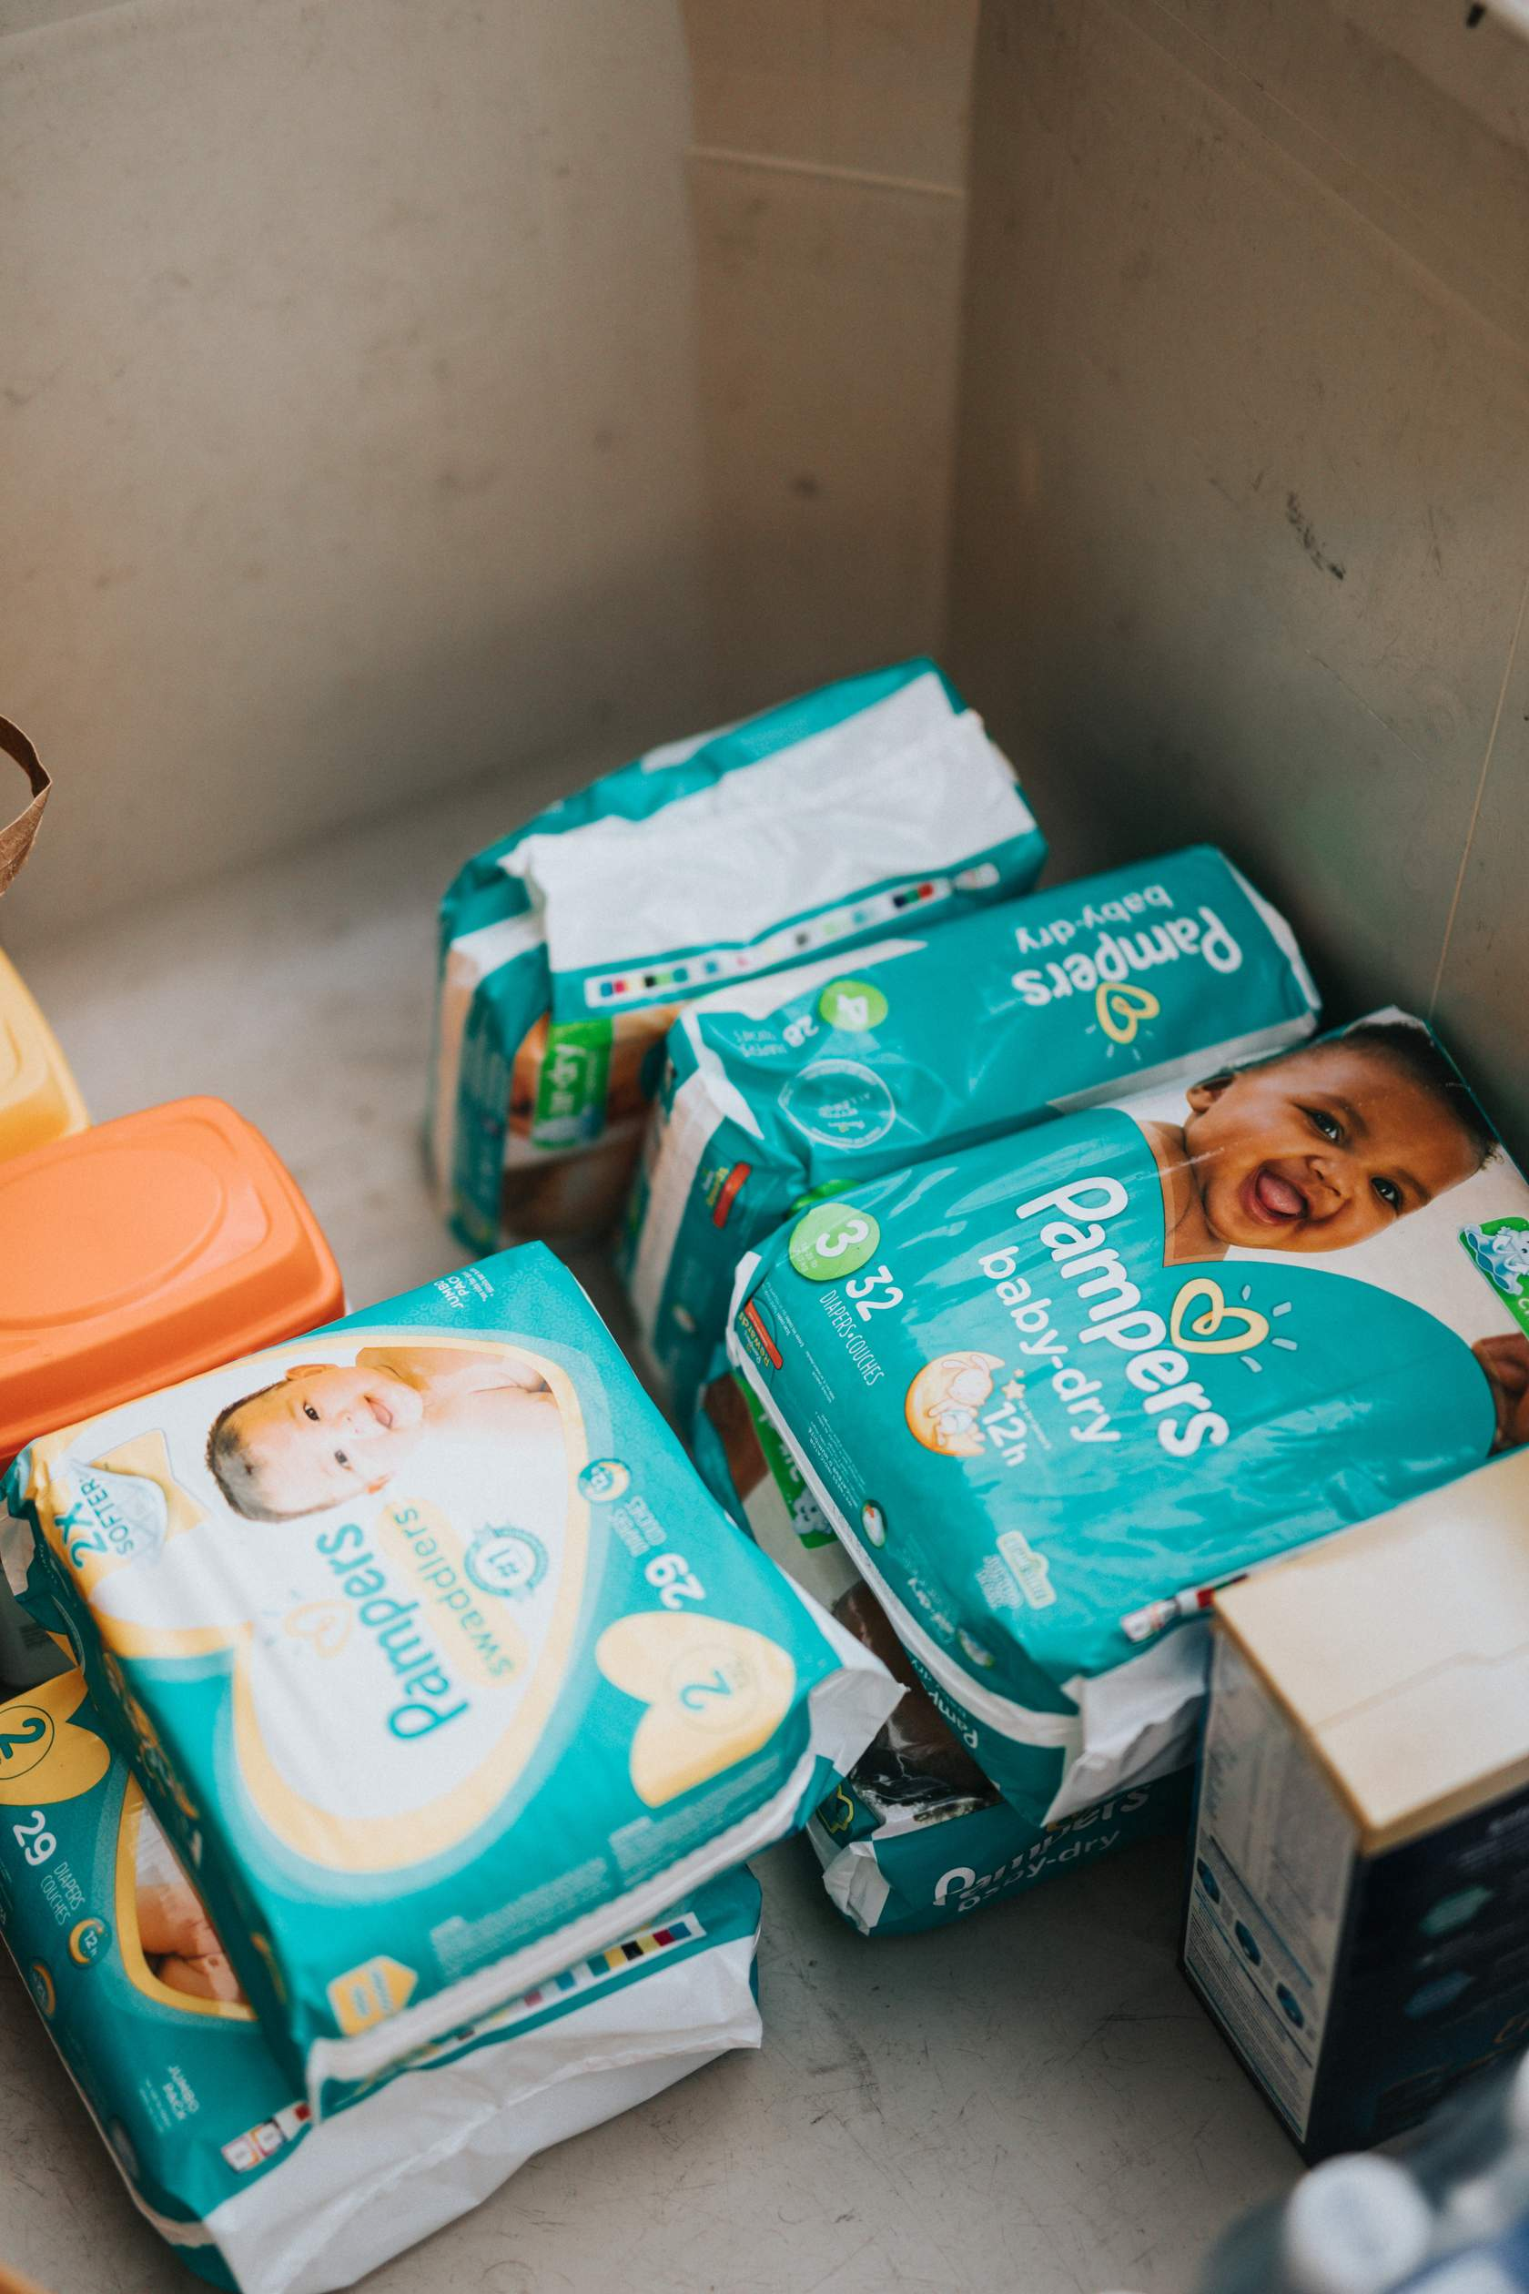
Rotavirus
A virus that causes severe diarrhea
Spread: From other people and surfaces.
Disease: Rotavirus causes vomiting, diarrhea, and fever. Once ill, infants can quickly become dehydrated. Before rotavirus vaccine was added to the childhood immunization schedule, up to 70,000 children were hospitalized each year in the U.S. due to rotavirus.
Vaccine reactions: Rare, mild reactions can include fever and diarrhea.
Notes:
Spread: from other people and surfaces, even if you keep your place very clean.
Disease: rotavirus causes vomiting, diarrhea, and fever. Once ill, infants can quickly become dehydrated. Before rotavirus vaccine was added to the childhood immunization schedule, up to 70,000 children were hospitalized each year in the US due to rotavirus.
Vaccine Reactions: this vaccine is given by mouth. There are vvery, very few side effects. If they occur, they are very mild, and can include fever and diarrhea.

Slide 33


Haemophilus influenzae type b (Hib)
It used to be the #1 bacteria to cause meningitis.
Spread: Through coughing or from contact with an infected person’s saliva.
Disease: Hib causes severe infections of the brain, throat, and blood. Meningitis is an inflamed lining of the brain and spinal cord.
The disease is extremely serious:
  Fatal in 5% of patients
  Causes brain damage in 10% to 30% of survivors
Vaccine reactions: This can cause soreness at the injection site. It is not associated with serious side effects.
Notes:
This used to be the #1 bacteria to cause meningitis.
Spread: Through coughing or from contact with an infected person’s saliva.
Disease: Hib causes severe infections of the brain, throat, and blood. (meningitis = inflamed lining of the brain and spinal cord)
The disease is extremely serious:
Fatal in 5% of patients
Causes brain damage in 10% to 30% of survivors
Vaccine reactions: This can cause soreness at the injection site. It is not associated with serious side effects.

Slide 34
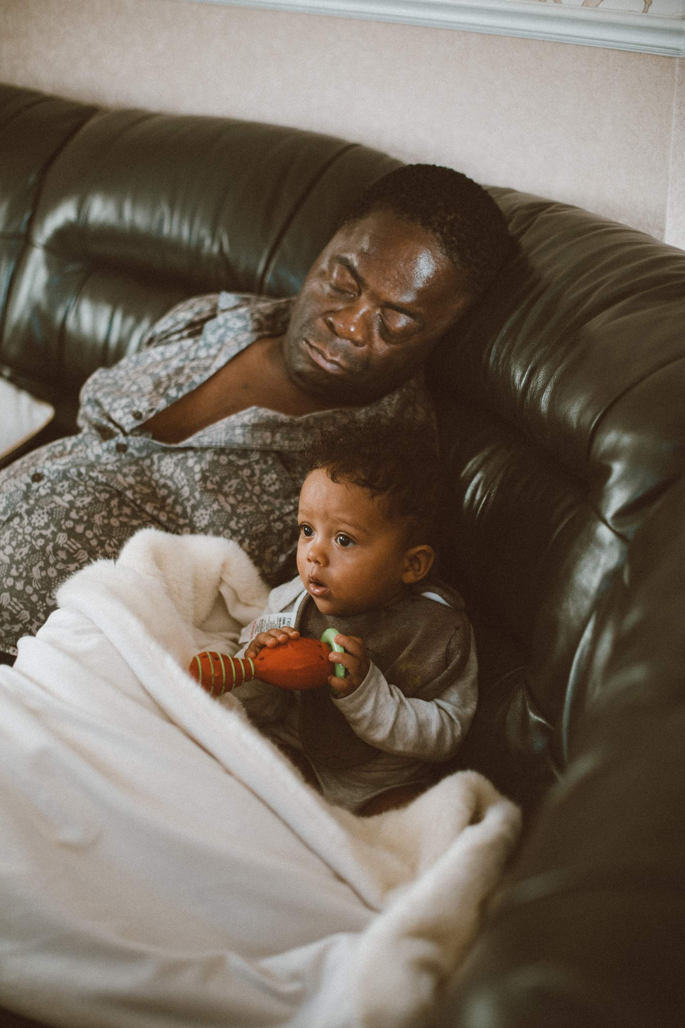
Pneumococcus
A bacteria that causes problems for young & old
Spread: People have the bacteria in their nose or throat, which spreads to others through direct contact with airway fluids.
Disease: Prior to the use of this vaccine, each year in the U.S. pneumococcal disease caused:
  5 million ear infections
  13,000 blood infections
  700 cases of meningitis
  200 deaths
Vaccine reactions: This vaccine can cause soreness at the injection site and low-grade fever.
Bonus! When children receive this vaccine, they don’t spread pneumococcus to grandparents.
Notes:
A bacteria that causes problems for young & old
Spread: Many people, especially children, have the bacteria in their nose or throat at some time, even without being ill. It spreads to others through direct contact with airway fluids, such as saliva or mucus.
Disease: Prior to the use of this vaccine, each year in the U.S. pneumococcal disease caused:
5 million ear infections
13,000 blood infections
700 cases of meningitis
200 deaths
Vaccine reactions: This vaccine can cause soreness at the injection site and low-grade fever. It is not associated with serious side effects.

Slide 35
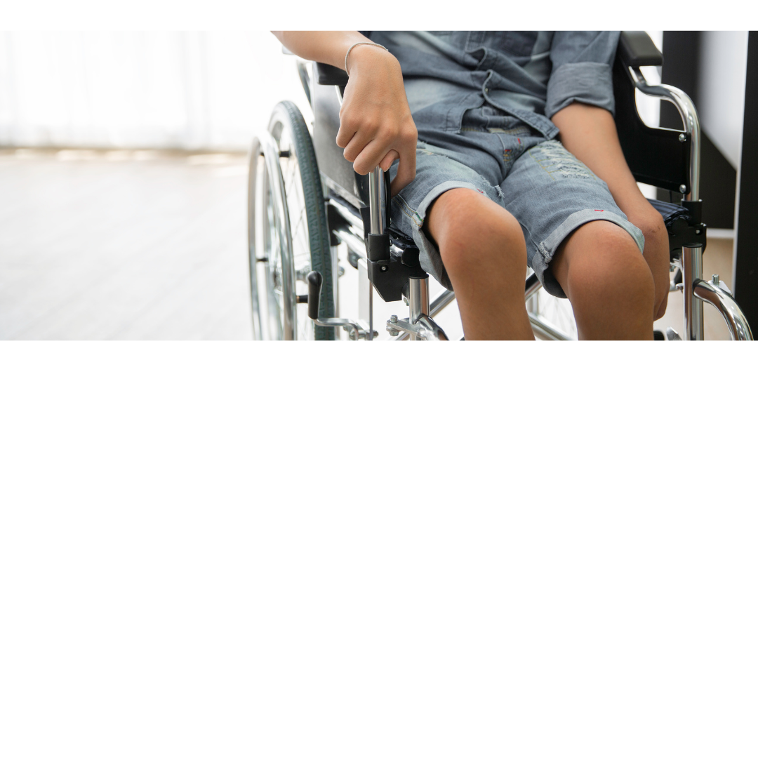
Polio
A virus that causes paralysis and limb "withering"
Spread: When the feces of an infected person gets into the mouth of another person through contaminated water or food.
Disease: Polio virus can spread to the nervous system and cause short- or long-term paralysis.
Vaccine reactions: May cause soreness where it was injected. It is not associated with serious side effects.
Notes:
Spread: when the feces (poop) of an infected person gets into the mouth of another person through contaminated water or food.
Disease: polio virus can spread to the nervous system and cause short- or long-term paralysis
Eradicate polio: while polio was eliminated from the US in 1979, it is only a plane ride away (or a trip to the airport). The world is trying to eradicate polio forever as we did with smallpox. Vaccinating your child is a key way to help reach this goal.
Vaccine reactions: polio vaccine may cause soreness where it was injected. It is not associated with serious side effects.

Slide 36


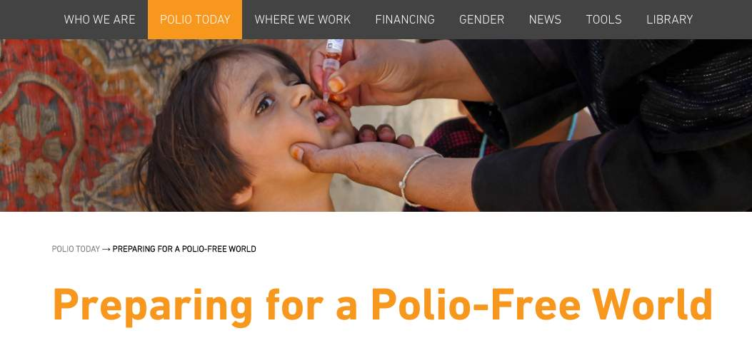
Polio
A virus that causes paralysis and limb "withering"
Eradicate polio!
Polio was eliminated from the United States in 1979; however, on a few occasions, cases have been identified in this country.
The world is trying to eradicate polio forever as we did with smallpox.
Vaccinating your child is a key way to help reach this goal.

Slide 37
What diseases can vaccines prevent?
Ages 7-18 years

Slide 38
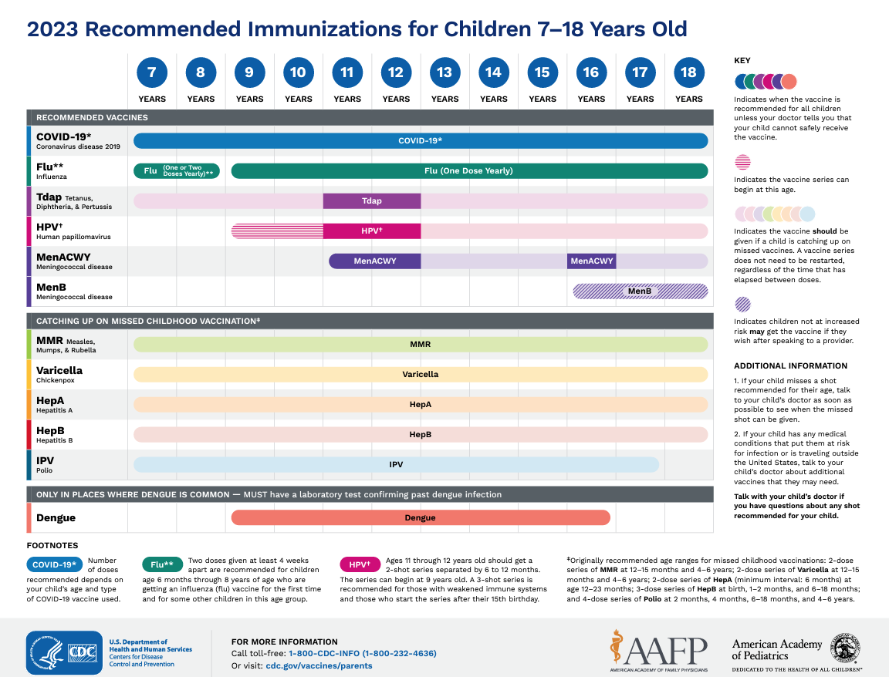
7 to 18 Years Immunization Schedule
Why do we want to prevent these diseases?
Click on the schedule to open the full PDF in web browser.
Notes:
View as PDF online: https://www.cdc.gov/vaccines/schedules/downloads/teen/parent-version-schedule-7-18yrs.pdf
In English and Spanish: https://www.cdc.gov/vaccines/schedules/easy-to-read/adolescent-easyread.html

Slide 39
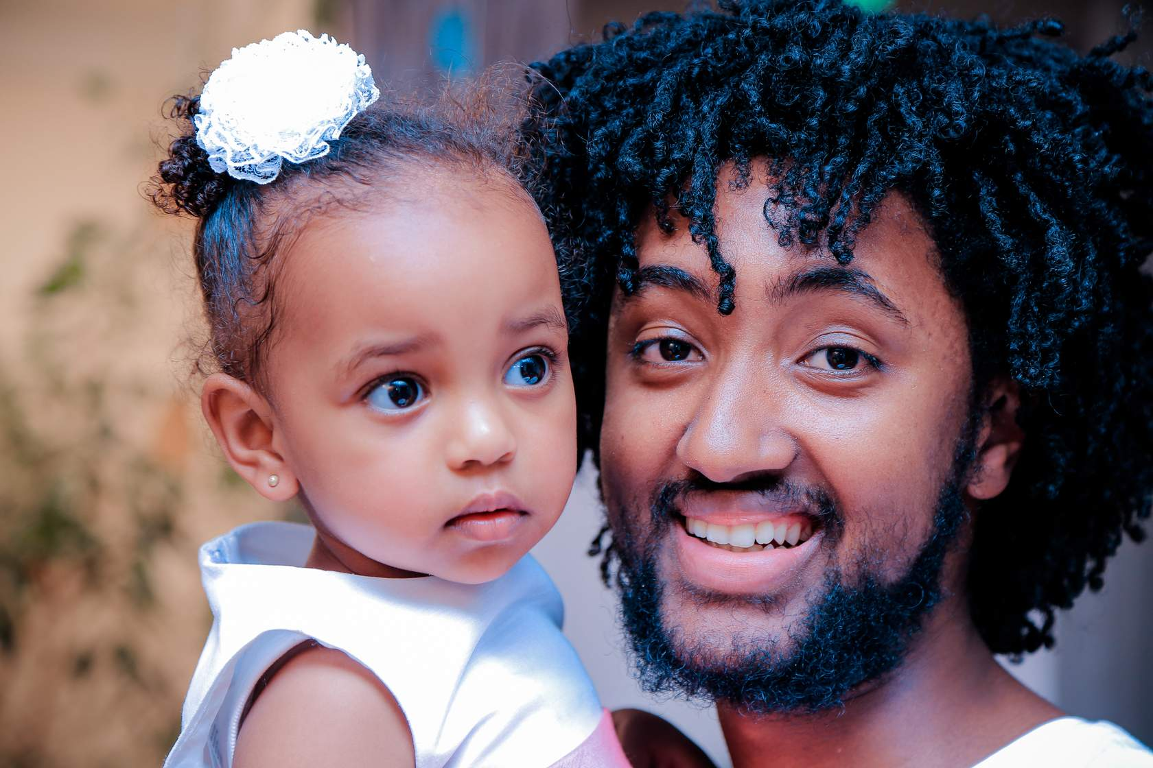
Pertussis (In the Tdap vaccine)
Also known as Whooping Cough
Spread: Droplets produced during coughing or sneezing carry the bacteria to others nearby. Many infants who get pertussis are infected by older siblings, parents, or caregivers who might not even known they have the disease.
Disease: After a week or two of 'cold' symptoms, the person may have…
  Fits of many, rapid coughs followed by a high-pitched “whoop” sound
  Throwing up during or after coughing fits
  Feeling very tired after coughing fits
Vaccine reactions: Redness, swelling, pain, and tenderness at the injection site is most common. Some people get body-ache, fatigue, or even a fever.
Notes:
Spread:
Droplets produced during coughing or sneezing carry the bacteria to others. These droplets don't travel very far through the air and usually only infect nearby people. Many infants who get pertussis are infected by older siblings, parents, or caregivers who might not even know they have the disease.
Disease: After a week or two of 'cold' symptoms, the person may have:
Fits of many, rapid coughs followed by a high-pitched “whoop” sound
Throwing up during or after coughing fits
Feeling very tired after coughing fits
Disease complications(opens in a new tab): Teens and adults often have complications that are unpleasant, but infants and young children are in danger.
1 out of 4 (23%) get lung infection
1 out of 100 (1.1%) will have convulsions
3 out of 5 (61%) will have slowed or stopped breathing
1 out of 300 (0.3%) will have disease of the brain
1 out of 100 (1%) will die
Vaccine reactions: Redness, swelling, pain, and tenderness at the injection site is most common. Some people get body-ache, fatigue, or even a fever.

Slide 40


Pertussis (In the Tdap vaccine)
Also known as Whooping Cough
Disease complications: Teens and adults often have complications that are unpleasant, but infants and young children are in danger.
  1 out of 4 (23%) get lung infection
  1 out of 100 (1.1%) will have convulsions
  3 out of 5 (61%) will have slowed or stopped breathing
  1 out of 300 (0.3%) will have disease of the brain
  1 out of 100 (1%) will die

Slide 41
Human Papillomavirus (HPV)
A virus that causes cancers
Spread: from mother to infant, non-sexually from person-to-person or sexually.
Disease: HPV can cause cancer of the base of the tongue and tonsils, cervix, vulva, vagina, penis, or anus. The cancer often develops years, or even decades, after infection.
Vaccine reactions: HPV vaccine can cause pain, redness, or swelling in the arm where the shot was given. A few adolescents get fever, fainting, nausea, headache, or tired feeling.
Notes:
Spread: from mother to infant, non-sexually from person-to-person (e.g., from the fingers to the genitals), or sexually (i.e., vaginal, anal, or oral sex with someone who has the virus).
Disease: HPV can cause cancer of the base of the tongue and tonsils, cervix, vulva, vagina, penis, or anus. The cancer often develops years, or even decades, after infection. It also can cause warts in the places it causes cancer.
Vaccine reactions: HPV vaccine can cause pain, redness, or swelling in the arm where the shot was given. A few adolescents get fever, fainting (fainting after any vaccine is more common among adolescents), nausea, headache, or tired feeling.
See the American Cancer Society "HPV Cancer Free" website

Slide 42

Human Papillomavirus (HPV)
A virus that causes cancers
Coverage: HPV vaccination rates have risen considerably over the past 10 years, but remain suboptimal. Coverage remains far below desired and far below most other adolescent vaccinations. Vaccination between ages 9-12 is best, but many miss this window. Because your child’s future marriage partner may not have been vaccinated, it’s even more important for your child to get the vaccine.
Visit the American Cancer Society "HPV Cancer Free" website

Slide 43

Meningococcus
Uncommon, but devastating
Spread: from person-to-person by coughing or coming into close or lengthy contact with someone who is sick or who carries the bacteria without knowing it.
  Contact includes kissing, sharing drinks, or living together.
  Up to 1-in-10 people carry this bacteria in their nose or throat without getting sick.
Disease: This causes severe infections of the brain and blood as well as loss of fingers, hands, feet, and limbs.
Vaccine reactions: As with the other vaccines in this lesson, this can cause soreness at the injection site, fever, headache, nausea, and fatigue.
Notes:
Spread: from person-to-person by coughing or coming into close or lengthy contact with someone who is sick or who carries the bacteria without knowing it.
Contact includes kissing, sharing drinks, or living together.
Up to 1-in-10 people carry this bacteria in their nose or throat without getting sick.
Disease: This causes severe infections of the brain and blood (meningitis = inflamed lining of the brain and spinal cord) as well as loss of fingers, hands, feet, and limbs.
Extremely serious:
Even with antibiotic treatment, 10-15% of infected people will die.
Up to 1-in-5 survivors will have long-term disabilities, such as loss of limb(s), deafness, nervous system problems, or brain damage.
Vaccine reactions: As with the other vaccines in this lesson, this can cause soreness at the injection site, fever, headache, nausea, and fatigue.

Slide 44


Meningococcus
Uncommon, but devastating
The disease can be extremely serious
  Meningitis is the inflamed lining of the brain and spinal cord.
  Even with antibiotic treatment, 10-15% of infected people will die.
  Up to 1-in-5 survivors will have long-term disabilities, such as loss of limb(s), deafness, nervous system problems, or brain damage.

Slide 45
On-time Vaccination
is the Best Choice

Slide 46
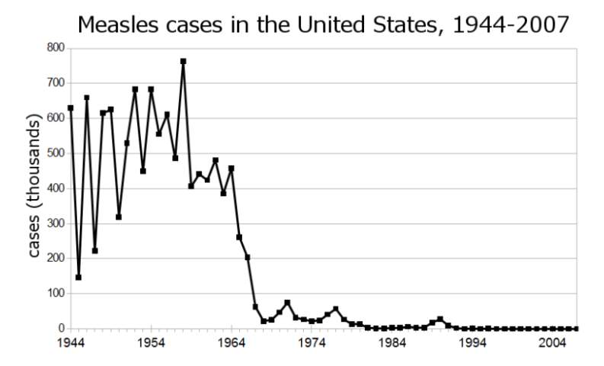
Then and Now
Vaccination is still the best choice
In the past, parents feared diseases such as measles, and were eager to have their children vaccinated.
Measles cases in the United States, 1944-2007
https://newsforkids.net/articles/2018/08/28/without-vaccines-measles-numbers-grow/
Notes:
In the past, parents feared diseases such as measles, and were eager to have their children vaccinated. They were heartened to see the rapid drop in disease rates after an effective measles vaccine became available in the early 1960s.
On-time vaccination is still the best choice for children and adolescents. Here's why.

Slide 47


Then and Now
Vaccination is still the best choice
If you want your child to be active in school and sports, immunization is the best choice.
On-time vaccination was and is still the best choice for children and adolescents.
Here's why…
Notes:
In the past, parents feared diseases such as measles, and were eager to have their children vaccinated. They were heartened to see the rapid drop in disease rates after an effective measles vaccine became available in the early 1960s.
On-time vaccination is still the best choice for children and adolescents. Here's why.

Slide 48
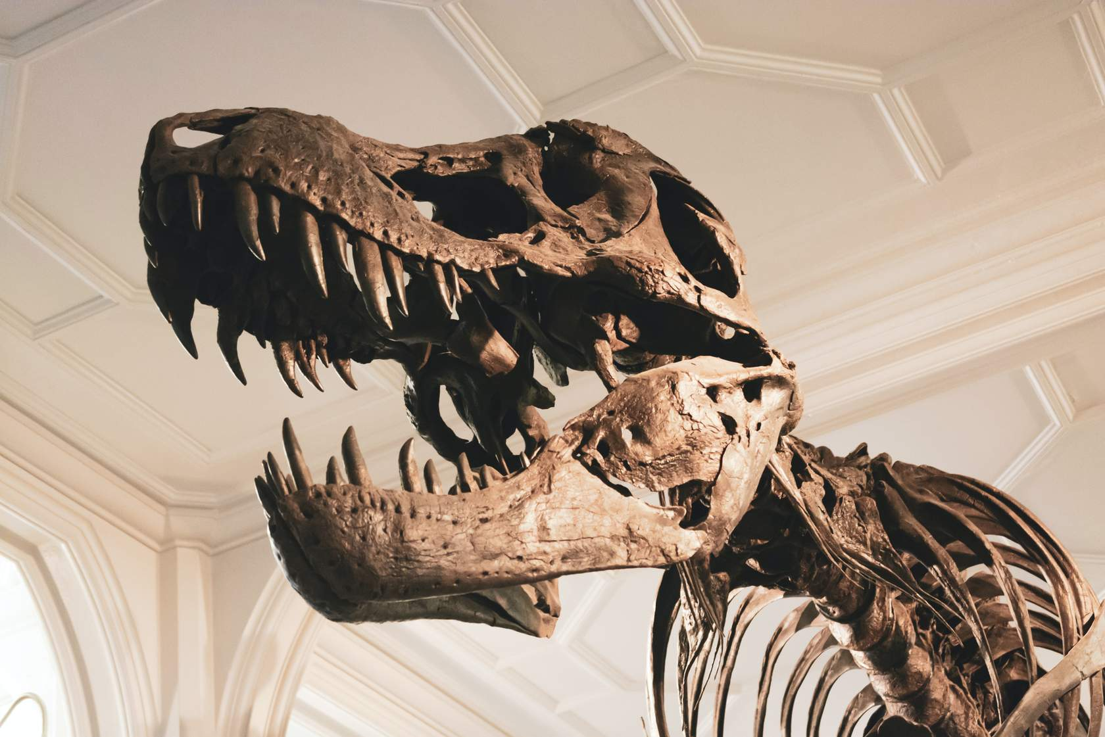
Vaccines are still needed.
Vaccine preventable diseases are still among us.
Dinosaurs are frightening, but extinct. Other than smallpox, the vaccine preventable diseases are still among us. Some diseases such as tetanus and flu will never be eradicated.
Notes:
Vaccine preventable diseases are still among us.
Dinosaurs are frightening, but extinct. Other than smallpox, the vaccine preventable diseases are still among us. Some diseases such as tetanus and flu will never be eradicated.

Slide 49
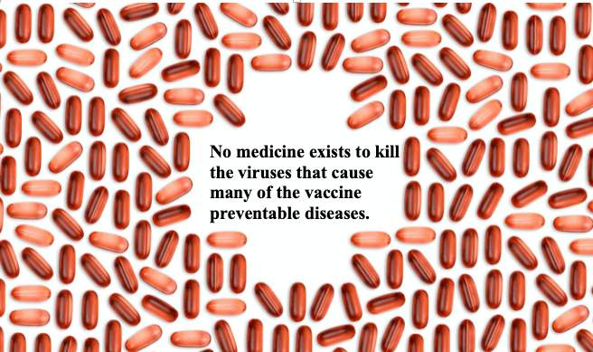
Vaccines are still needed.
There is no medicine to kill many viruses.
Once you are infected with many viruses, we can treat symptoms, but there is no medicine to rid the body of the infection.
Notes:
There is no medicine to kill many viruses.
Once you are infected with many viruses (for example, measles, polio, HPV) we can treat symptoms and try to prevent complications, but there is no medicine to rid the body of the infection.

Slide 50
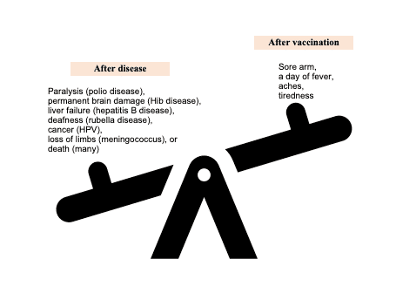
Vaccines are still needed.
Vaccination is better than natural infection.
Vaccination is better than natural infection because vaccination has LESS side effects.
After vaccination people may have a sore arm, a day of fever, aches, tiredness.
After natural infection people may have:
Paralysis (polio disease)
Permanent brain damage (Hib disease)
Liver failure (hepatitis B disease)
Deafness (rubella disease)
Cancer (HPV)
Loss of limbs (meningococcus)
Death (many)
Notes:
In some cases, after vaccination our bodies make more or more effective antibodies than after natural infection. However, usually this is not the case.
Vaccination is better than natural infection because vaccination has LESS side effects. While after vaccination people may have a sore arm, a day of fever, aches, tiredness. After natural infection people may have
Paralysis (polio disease)
Permanent brain damage (Hib disease)
Liver failure (hepatitis B disease)
Deafness (rubella disease)
Cancer (HPV)
Loss of limbs (meningococcus)
Death (many)

Slide 51

Vaccines are still needed.
Vaccines help prevent the spread of disease.
Vaccines protect the person who receives them and, indirectly, the people close to them.
Notes:
Vaccines help prevent the spread of disease.
Vaccines protect the person who receives them and, indirectly, the people close to them.

Slide 52

Vaccines are still needed.
Prevention is better than a cure (or just hoping my loved one is not infected).
Protection through vaccination has been shown to be more effective and safer.
There is no specific medicine to fight most of the viruses that cause vaccine-preventable diseases. For example, there is no specific medicine against polio virus, HPV, or measles.
Notes:
Just hoping that your loved one will not be infected is not much of a strategy. Protection through vaccination has been shown to be more effective and safer.
There is no specific medicine to fight most of the viruses that cause vaccine-preventable diseases. For example, there is no specific medicine against polio virus, HPV, or measles. Cure is not even an option for these.

Slide 53
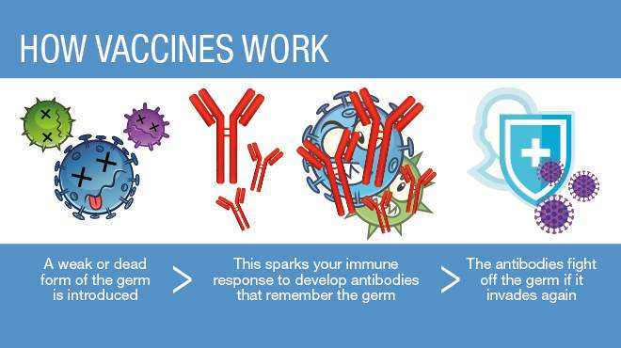
2) Vaccines work.
Vaccines work with the natural immune system.
A vaccine contains some part or parts of the disease germ – called antigens.
When the antigen is injected, the body recognizes the invader and makes antibodies.
Unlike the actual disease germ, the vaccine does not overwhelm the immune system; the person does not get the disease.
While the antibodies fight the antigens, the immune system creates memory cells to help fight off the disease should the person ever be exposed to it again.
Notes:
Vaccines work with the natural immune system.
A vaccine contains some part or parts of the disease germ – called antigens.
When the antigen is injected, the body recognizes the invader and makes antibodies.
Unlike the actual disease germ, the vaccine does not overwhelm the immune system; the person does not get the disease.
While the antibodies fight the antigens, the immune system creates memory cells to help fight off the disease should the person ever be exposed to it again.
https://www.mayoclinichealthsystem.org/hometown-health/speaking-of-health/vaccine-safety-6-common-questions-answered

Slide 54
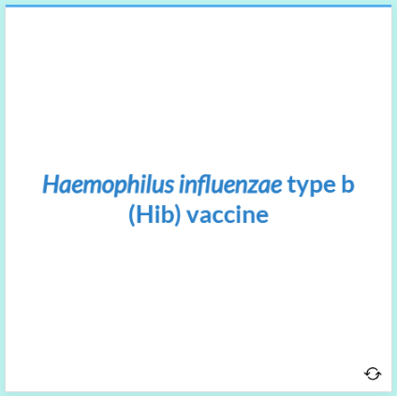
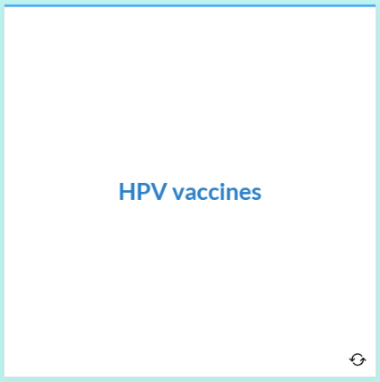
2) Vaccines work.
This system really works!
Notes:
Hib
After getting a full series of the modern Hib vaccine, more than 95% of infants develop antibody levels high enough to provide protection.
HPV
Scientists did an analysis of data on more than 60 million vaccinated girls in 14 countries. They looked at infections with the 2 most common cancer-causing HPV types. They found that compared with the period before vaccination these infections decreased by 83% among girls aged 15-19 years.

Slide 55
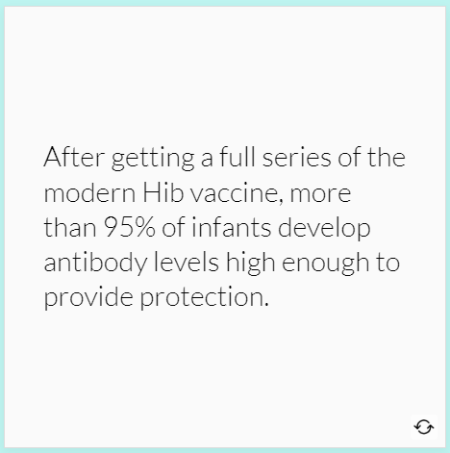
2) Vaccines work.
This system really works!
Notes:
Hib
After getting a full series of the modern Hib vaccine, more than 95% of infants develop antibody levels high enough to provide protection.
HPV
Scientists did an analysis of data on more than 60 million vaccinated girls in 14 countries. They looked at infections with the 2 most common cancer-causing HPV types. They found that compared with the period before vaccination these infections decreased by 83% among girls aged 15-19 years.

Slide 56
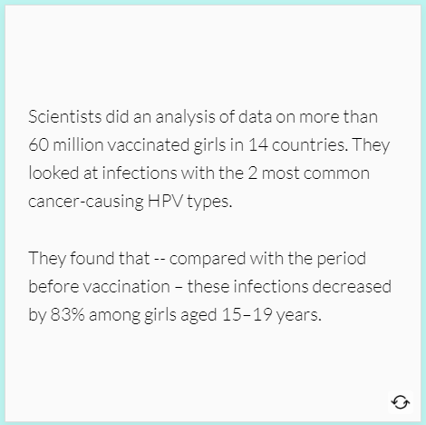
2) Vaccines work.
This system really works!
Notes:
Hib
After getting a full series of the modern Hib vaccine, more than 95% of infants develop antibody levels high enough to provide protection.
HPV
Scientists did an analysis of data on more than 60 million vaccinated girls in 14 countries. They looked at infections with the 2 most common cancer-causing HPV types. They found that compared with the period before vaccination these infections decreased by 83% among girls aged 15-19 years.

Slide 57

2) Vaccines are safe.
Vaccine ingredients are safe.
The ingredients in vaccines may sound scary, but most of them are already part of our environments.
Notes:
Vaccines work with the natural immune system.
A vaccine contains some part or parts of the disease germ – called antigens.
When the antigen is injected, the body recognizes the invader and makes antibodies.
Unlike the actual disease germ, the vaccine does not overwhelm the immune system; the person does not get the disease.
While the antibodies fight the antigens, the immune system creates memory cells to help fight off the disease should the person ever be exposed to it again.
https://www.mayoclinichealthsystem.org/hometown-health/speaking-of-health/vaccine-safety-6-common-questions-answered

Slide 58
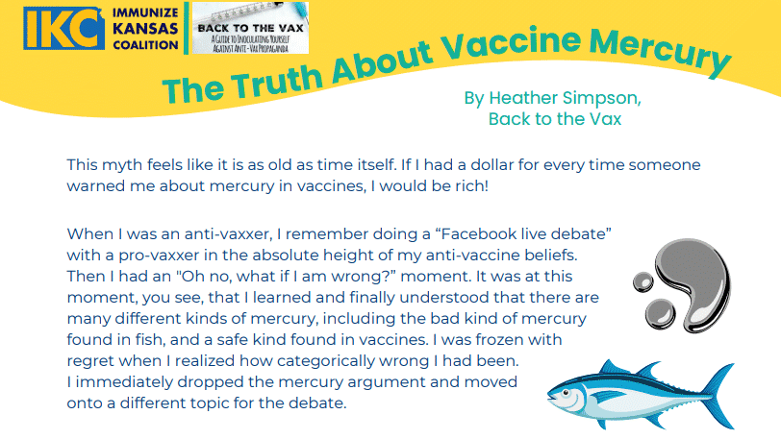
2) Vaccines are safe.
Thimerosal
This organic mercury compound is used in some vaccines as a preservative.
It was removed from routine childhood immunizations (except some influenza vaccines) as a precaution before further research was done.
Since then, studies have shown that thimerosal is quickly cleared from the body and poses much less of a health risk than other mercury compounds.
In the amounts that used to be found in vaccines, thimerosal is safe.
Notes:
Thimerosal
This organic mercury compound is used in some vaccines as a preservative.
It was removed from routine childhood immunizations (except some influenza vaccines) as a precaution before further research was done.
Since then, studies have shown that thimerosal is quickly cleared from the body and poses much less of a health risk than other mercury compounds.
In the amounts that used to be found in vaccines, thimerosal is safe.
For more on thimerosal, see:
IKC's One-Page Sheet "The Truth About Vaccine Mercury(opens in a new tab)" (the top of the sheet is shown above)
Children's Hospital of Philadelphia, Vaccine Education Center(opens in a new tab).

Slide 59
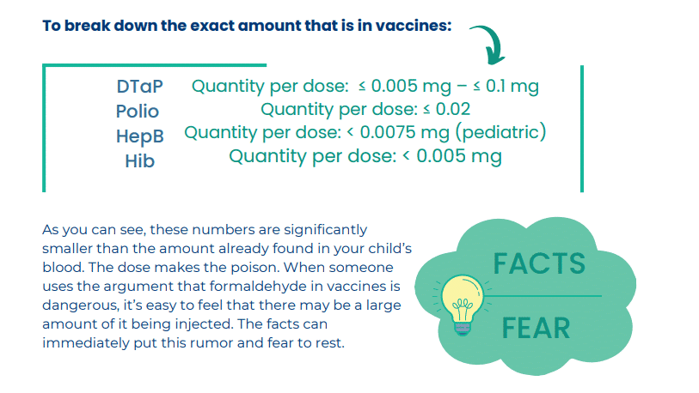
2) Vaccines are safe.
Formaldehyde
This is used during the manufacturing of some vaccines.
Our bodies produce formaldehyde as a natural byproduct of metabolism. So, we all have formaldehyde in our circulation.
Very high doses of formaldehyde may pose some risk, but our bodies can handle lower doses.
The amount of formaldehyde a 2-month old can handle is 1,500 times more than the amount an infant would be exposed to in any individual vaccine.
Even a pear can contain much more formaldehyde than a vaccine (up to 600 times more).
Notes:
Formaldehyde
This is used during the manufacturing of some vaccines.
Our bodies produce formaldehyde as a natural byproduct of metabolism. So, we all have formaldehyde in our circulation.
Very high doses of formaldehyde may pose some risk, but our bodies can handle lower doses.
The amount of formaldehyde a 2-month old can handle is 1,500 times more than the amount an infant would be exposed to in any individual vaccine.
Even a pear can contain much more formaldehyde than a vaccine (up to 600 times more).
For more on formaldehyde, see:
IKC's One-Page Sheet "Facts Dismantle Fears of Formaldehyde(opens in a new tab)" (part of the sheet is shown above)
The Children's Hospital of Philadelphia, Vaccine Education Center

Slide 60
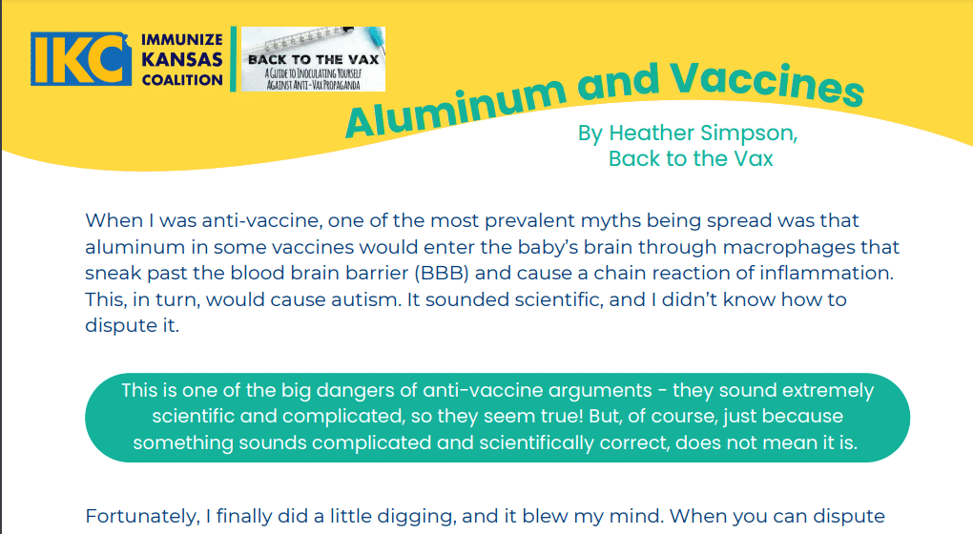
2) Vaccines are safe.
Aluminum
Aluminum is the third most common mineral in the earth’s crust, so it's everywhere--in air, food, breast milk and formula.
Aluminum salts (not elemental aluminum) are used as an adjuvant in vaccines. Adjuvants help the body’s immune system respond to the antigens in vaccines so that smaller amounts of antigens need to be used in our vaccines.
The amount of aluminum salts in vaccines is miniscule—and is easily processed by young children.
Notes:
Aluminum
Aluminum is the third most common mineral in the earth’s crust, so it's everywhere--in air, food, breast milk and formula.
Aluminum salts (not elemental aluminum) are used as an adjuvant in vaccines. Adjuvants help the body’s immune system respond to the antigens in vaccines so that smaller amounts of antigens need to be used in our vaccines.
The amount of aluminum salts in vaccines is miniscule—and is easily processed by young children.
For more on aluminum, see the Children's Hospital of Philadelphia, Vaccine Education Center(opens in a new tab).

Slide 61
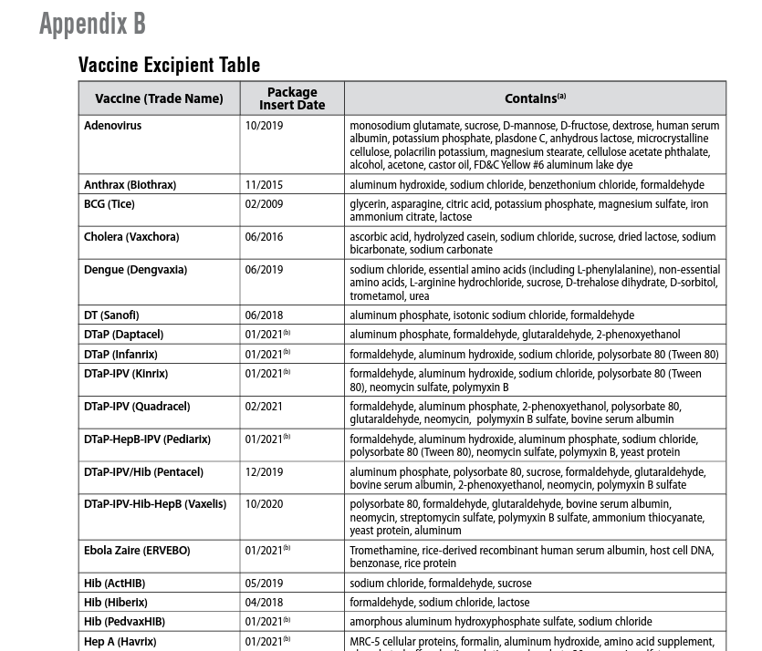
2) Vaccines are safe.
The Centers for Disease Control and Prevention (CDC) lists the vaccine ingredients in a table.
The table may be helpful for people concerned about particular allergies or ingredients. However, the table does not indicate how much of each ingredient is in the vaccine.
Notes:
The Centers for Disease Control and Prevention (CDC) lists the vaccine ingredients in a table(opens in a new tab). The table may be helpful for people concerned about particular allergies or ingredients. However, the table does not indicate how much of each ingredient is in the vaccine.

Slide 62
Discussion Points

Slide 63
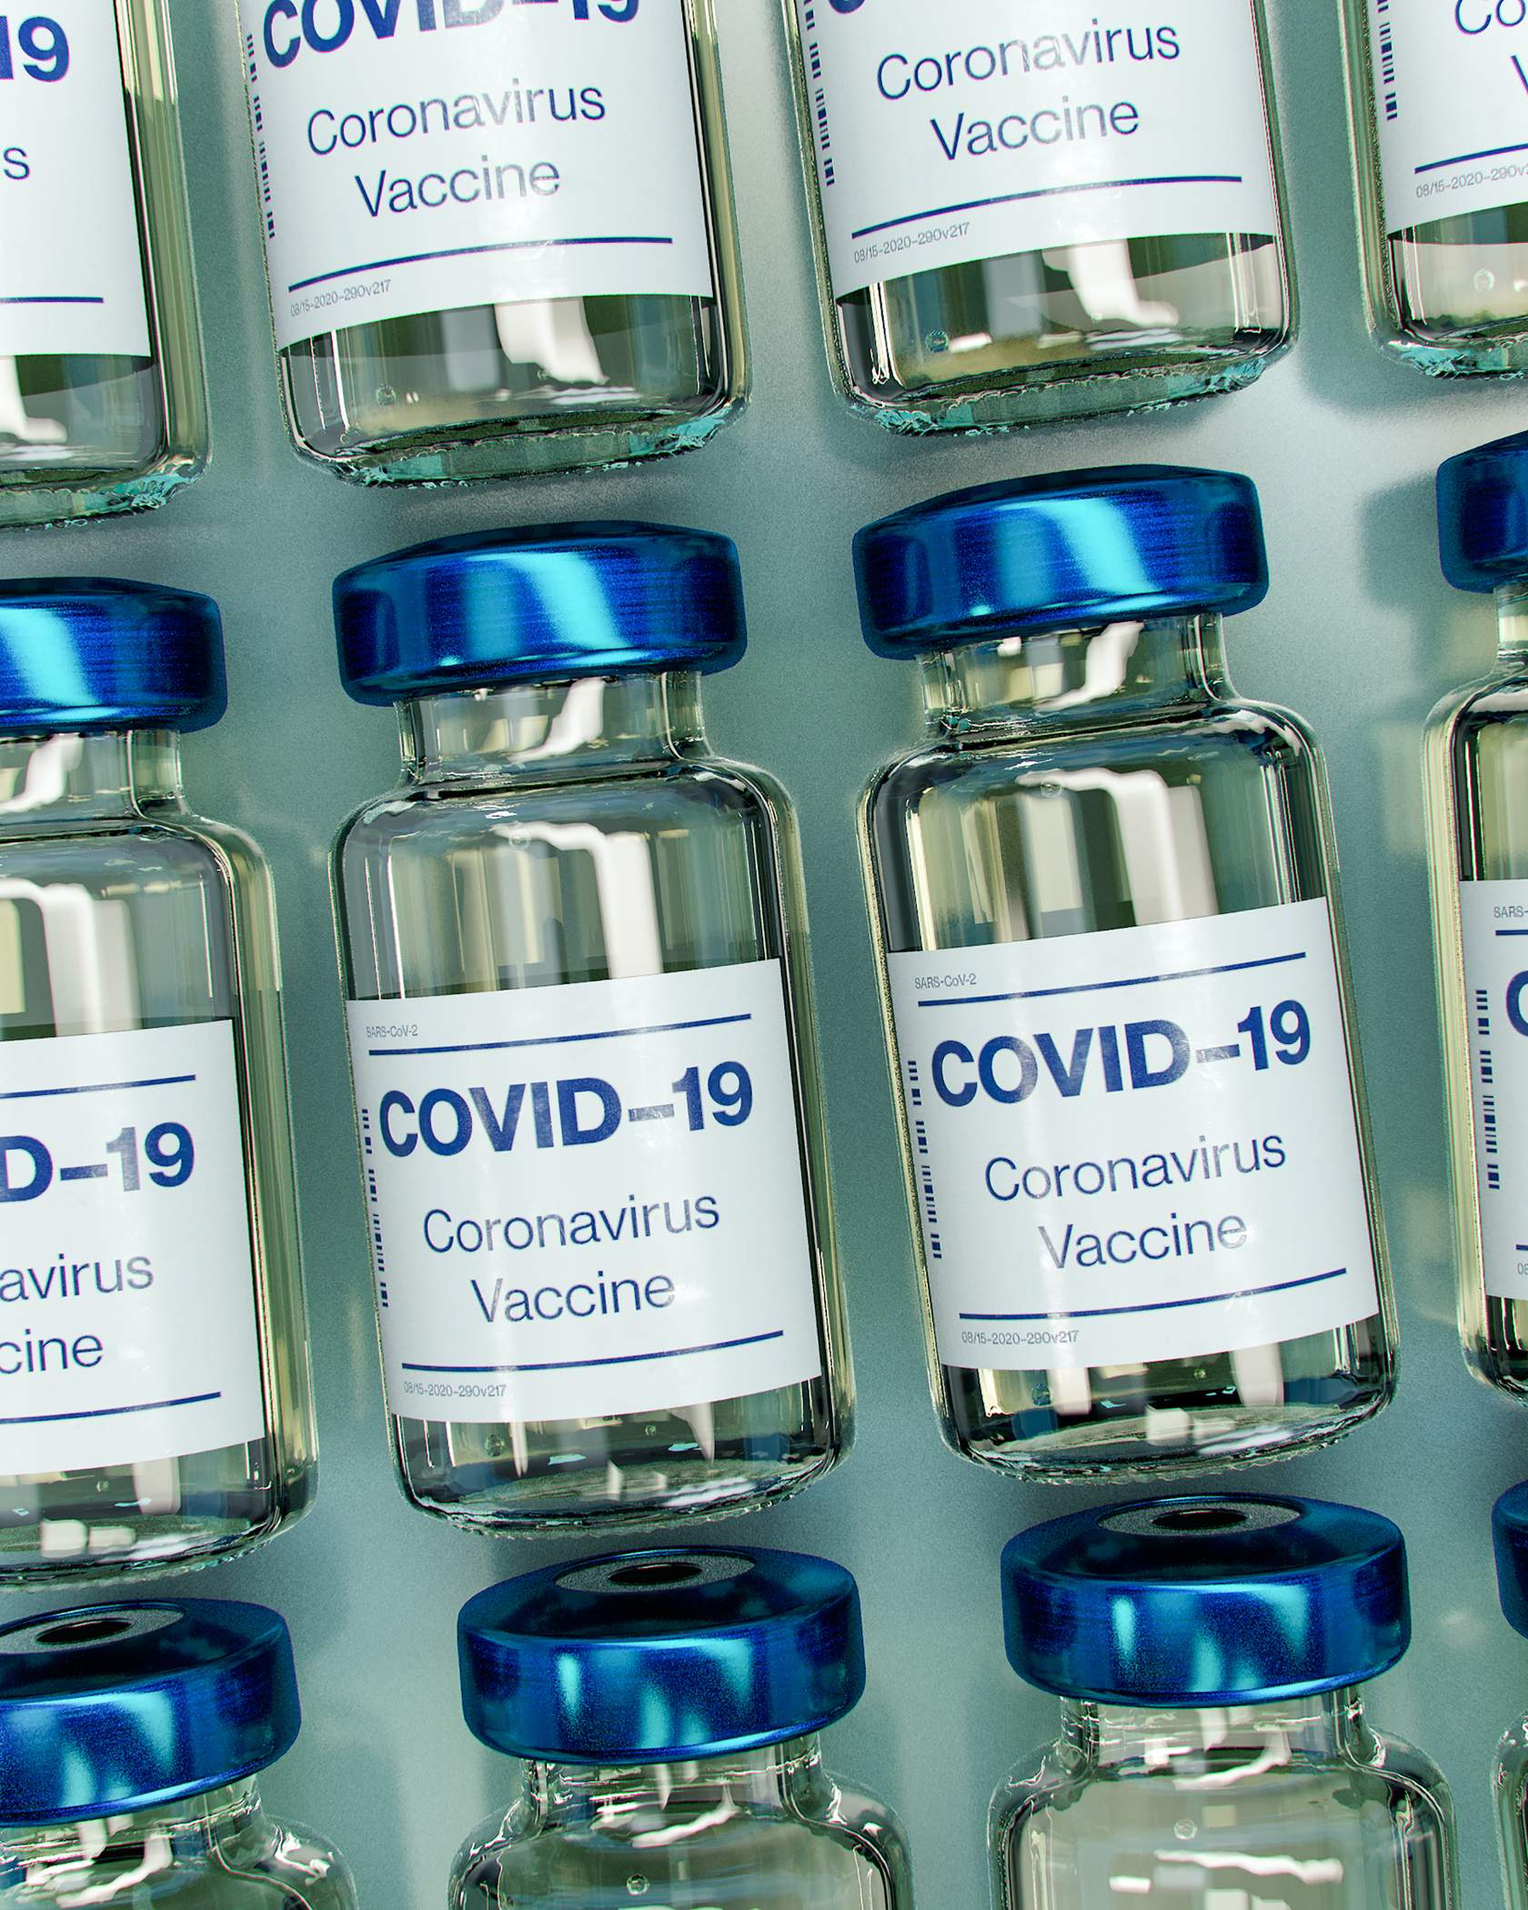
COVID-19 Vaccine
COVID-19 lockdowns helped reduce illness, but we all wanted to get back to normal life!
Through October 5, 2022, more than 6.4 million 12- to 17-year-olds got COVID-19 and 785 died.
Parents and physicians hope vaccination makes COVID-19 a thing of the past.
As of October 2022, there are COVID-19 vaccines (both Pfizer & Moderna) available for children 6 months-4 years and children 5-17 years.
Notes:
COVID-19 lockdowns helped reduce illness, but we all wanted to get back to normal life!
Through October 5, 2022(opens in a new tab), more than 6.4 million 12- to 17-year-olds got COVID-19 and 785 12-17-year-olds died.
Parents and physicians hope vaccination makes COVID-19 a thing of the past.
As of October 2022(opens in a new tab), there are COVID-19 vaccines (both Pfizer & Moderna) available for children 6 months-4 years and children 5-17 years.
For the most up-to-date information, please check:
Vaccine Education Center:
https://www.chop.edu/centers-programs/vaccine-education-center(opens in a new tab)
https://www.chop.edu/centers-programs/vaccine-education-center/making-vaccines/prevent-covid(opens in a new tab)
American Academy of Pediatrics: www2.aap.org/immunization(opens in a new tab)
Centers for Disease Control and Prevention: www.cdc.gov/vaccines

Slide 64
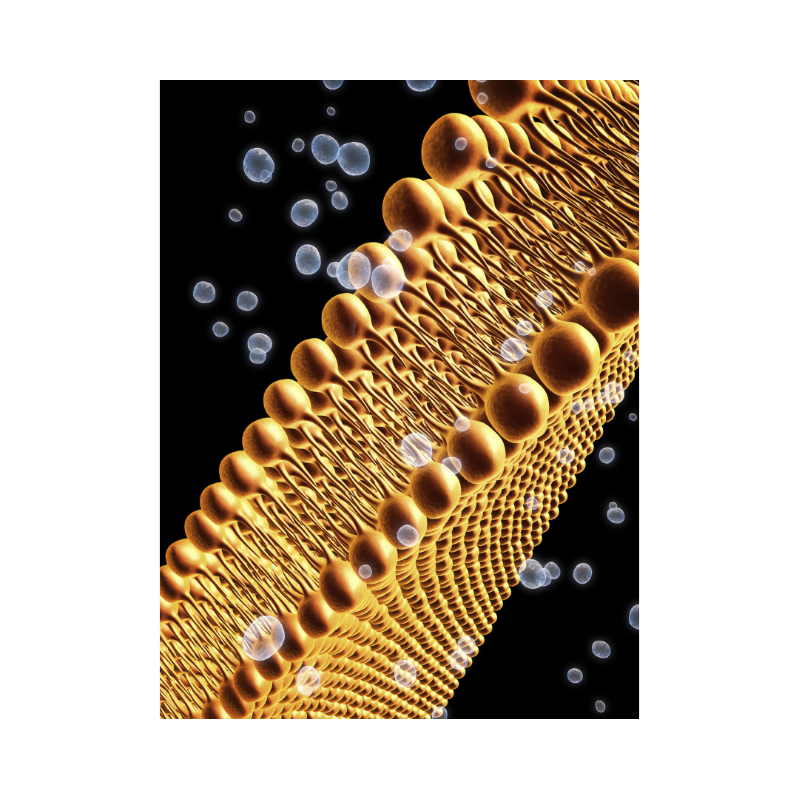
Fetal Cells
Production of varicella, rubella, rabies (one version), hepatitis A, and COVID-19 (one version) vaccines involve growing viruses in human cell culture.
Two human cell lines provide these cultures; they were developed from two aborted fetuses in the 1960s.
The donor fetuses were not aborted for the purpose of obtaining these cells.
The same cell lines have been used for many decades – no new fetal tissue is required.
Notes:
Fetal cells
Production of varicella, rubella, rabies (one version), hepatitis A, and COVID-19 (one version) vaccines involve growing viruses in human cell culture.
Two human cell lines provide these cultures; they were developed from two aborted fetuses in the 1960s.
The donor fetuses were not aborted for the purpose of obtaining these cells.
The same cell lines have been used for many decades – no new fetal tissue is required.
For the most in-depth discussion of this, please see:
Vaccine Education Center: https://www.chop.edu/centers-programs/vaccine-education-center/vaccine-ingredients/fetal-tissues(opens in a new tab)
Immunize.org: https://www.immunize.org/talking-about-vaccines/religious-concerns.asp

Slide 65

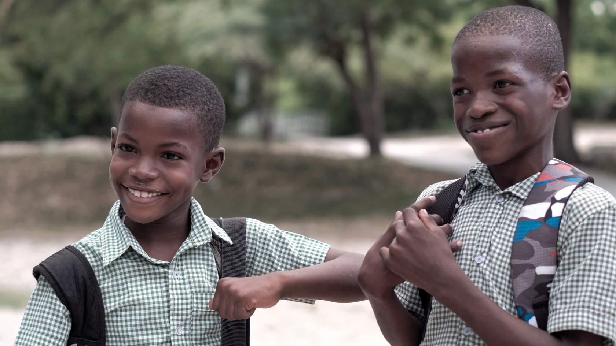
School Requirements
We live in communities so we depend on each other to stop at red lights.
Similarly, we ask kids to be vaccinated so they don't put others in their school in danger.
Notes:
We live in communities so we depend on each other to stop at red lights. Similarly, we ask kids to be vaccinated so they don't put others in their school in danger.
For up-to-date info, please see:
Centers for Disease Control and Prevention: https://www.cdc.gov/vaccines/parents/records/find-records.html(opens in a new tab)
Immunize.org: https://www.immunize.org/laws/(opens in a new tab)
Kansas Department of Health & Environment: https://www.kdhe.ks.gov/214/Immunizations(opens in a new tab)
Vaccination requirements vary by state.

Slide 66
More Resources

Slide 67
Videos from Different Faith Communities in Kansas
Below are 3 videos from IKC’s Honest Conversation Campaign
Dr. Presephoni Fuller, Pastor at South Church of God in Liberal, KS
Rocio Pérez, Mother of Four, Certified Nursing Assistant, and Pastor’s Wife in Ulysses, KS
Fernando Alvarez, Pastor in Garden City, KS

Slide 68
Videos from Different Faiths by Faiths 4 Vaccines
Jewish Rabbi - Rabbi Uses Social Media to Reduce Vaccine Hesitancy
American Baptist Church Pastor - American Baptist Churches USA Encourages All Persons to Receive the Vaccine
Bethany Baptist Church Pastor – Faith at the Forefront of Vaccination Efforts
Muslim – Why I took the Vaccine

Slide 69
More Resources
Jewish
Rabbinical Assembly Statement (COVID-19):
https://www.rabbinicalassembly.org/sites/default/files/2021-01/Vaccination%20and%20Ethical%20Questions%20Posed%20by%20COVID-19%20Vaccines%20-%20Final.pdf(opens in a new tab)
Christian (Mostly Protestant)
Biologos:
https://biologos.org/common-questions/should-christians-get-vaccinated(opens in a new tab)
The Gospel Coalition
  Vaccines in General:
  https://www.thegospelcoalition.org/article/what-christians-should-know-vaccines(opens in a new tab)
Focus on the Family
  Vaccines in General:
  https://www.focusonthefamily.com/family-qa/vaccination-and-immunization/(opens in a new tab)
Christians and the Vaccine (COVID):
https://www.christiansandthevaccine.com/(opens in a new tab)
United Methodist Health Ministry Fund - Faith in Vaccines - Resources for Congregation Leaders:
https://healthfund.org/a/faith-in-vaccines(opens in a new tab)
Notes:
Jewish
Rabbinical Assembly Statement (COVID-19):
https://www.rabbinicalassembly.org/sites/default/files/2021-01/Vaccination%20and%20Ethical%20Questions%20Posed%20by%20COVID-19%20Vaccines%20-%20Final.pdf(opens in a new tab)
Christian (Mostly Protestant)
Biologos:
https://biologos.org/common-questions/should-christians-get-vaccinated(opens in a new tab)
The Gospel Coalition
Vaccines in General:
https://www.thegospelcoalition.org/article/what-christians-should-know-vaccines(opens in a new tab)
Focus on the Family
Vaccines in General:
https://www.focusonthefamily.com/family-qa/vaccination-and-immunization/(opens in a new tab)
Christians and the Vaccine (COVID):
https://www.christiansandthevaccine.com/(opens in a new tab)
United Methodist Health Ministry Fund - Faith in Vaccines - Resources for Congregation Leaders:
https://healthfund.org/a/faith-in-vaccines(opens in a new tab)

Slide 70
More Resources
Catholic
Vatican Statement on the Morality of Using Some COVID-19 Vaccines: https://www.vatican.va/roman_curia/congregations/cfaith/documents/rc_con_cfaith_doc_20201221_nota-vaccini-anticovid_en.html(opens in a new tab)
COVID-19 vaccines: https://www.cacatholic.org/CCC-vaccine-moral-acceptability
As a Catholic, should I take the (COVID-19) vaccine?: https://stfparish.com/pastors-message/as-a-catholic-should-i-take-the-vaccine/
What does the Catholic church teach about vaccines?: https://angelusnews.com/news/life-family/what-does-the-catholic-church-teach-about-vaccines
Ethics & Medics - Vaccines Originating in Abortion: https://www.immunize.org/talking-about-vaccines/furton.pdf(opens in a new tab)
Islam
Interview with an Imam:
https://www.interfaithamerica.org/article/faith-and-the-covid-19-vaccine-muslims-were-among-the-first-to-believe-in-vaccines/
For Muslims wary of the Covid vaccine: there's every religious reason not to be:
https://www.theguardian.com/commentisfree/2021/feb/18/muslims-wary-covid-vaccine-religious-reason
As A Muslim Doctor, I Don’t Say Vaccination Is Permissible, I say it is Obligatory:
https://www.interfaithamerica.org/article/as-a-muslim-doctor-i-dont-say-vaccination-is-permissible-i-say-it-is-obligatory
Notes:
Catholic
Vatican Statement on the Morality of Using Some COVID-19 Vaccines: https://www.vatican.va/roman_curia/congregations/cfaith/documents/rc_con_cfaith_doc_20201221_nota-vaccini-anticovid_en.html(opens in a new tab)
COVID-19 vaccines:
https://www.cacatholic.org/CCC-vaccine-moral-acceptability(opens in a new tab)
As a Catholic, should I take the (COVID-19) vaccine?: https://stfparish.com/pastors-message/as-a-catholic-should-i-take-the-vaccine/(opens in a new tab)
What does the Catholic church teach about vaccines?: https://angelusnews.com/news/life-family/what-does-the-catholic-church-teach-about-vaccines/ (opens in a new tab)
Ethics & Medics - Vaccines Originating in Abortion: https://www.immunize.org/talking-about-vaccines/furton.pdf(opens in a new tab)
Islam
Interview with an Imam:
https://www.interfaithamerica.org/article/faith-and-the-covid-19-vaccine-muslims-were-among-the-first-to-believe-in-vaccines/
For Muslims wary of the Covid vaccine: there's every religious reason not to be:
https://www.theguardian.com/commentisfree/2021/feb/18/muslims-wary-covid-vaccine-religious-reason(opens in a new tab)
As A Muslim Doctor, I Don’t Say Vaccination Is Permissible, I say it is Obligatory:
https://www.interfaithamerica.org/article/as-a-muslim-doctor-i-dont-say-vaccination-is-permissible-i-say-it-is-obligatory/

Slide 71
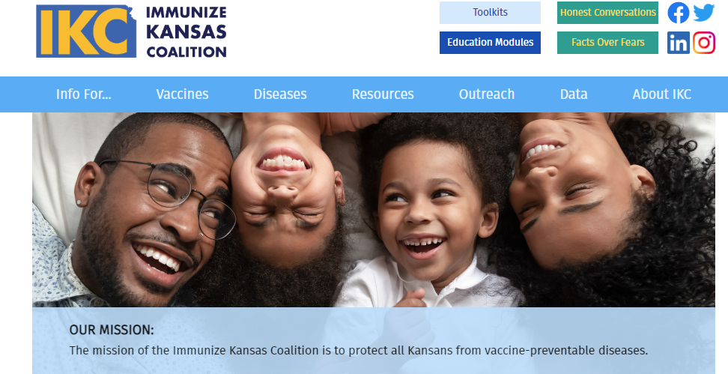
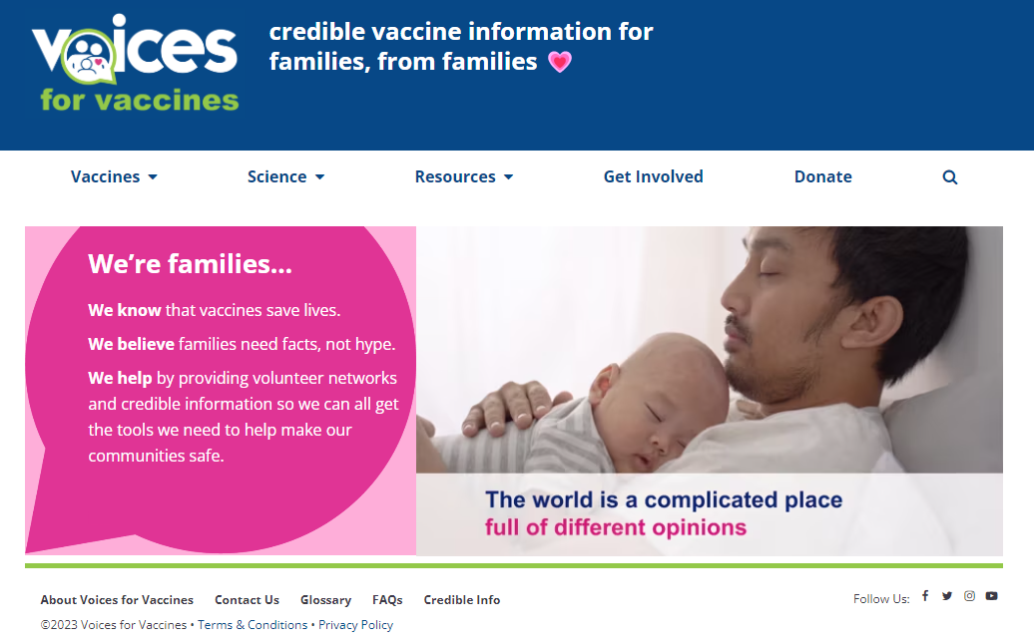
Reliable Immunization Websites
Immunize Kansas Coalition: : The vision of IKC is to protect all Kansans from vaccine-preventable diseases by working with communities to ensure equitable vaccine access for all people and to be the trusted resource for evidence-based information to support immunization decision making for individuals, families, and policy makers.
immunizekansascoalition.org
Voices for Vaccines: We received inspiration & help for this module from the parent-led group, Voices for Vaccines. Voices for Vaccines supports and advocates for on-time vaccination and the reduction of vaccine-preventable disease.
voicesforvaccines.org
Notes:
Please visit us at https://www.immunizekansascoalition.org/
Check out https://www.voicesforvaccines.org/resources/(opens in a new tab)

Slide 72
More great vaccine websites
Vaccine Education Center: https://www.chop.edu/centers-programs/vaccine-education-center
Immunization Action Coalition: www.vaccineinformation.org
American Academy of Pediatrics: https://www.aap.org/en/patient-care/immunizations
Centers for Disease Control and Prevention: www.cdc.gov/vaccines
Vaccinate Your Family: www.vaccinateyourfamily.org
The History of Vaccines: www.historyofvaccines.org
Notes:
More great vaccine websites
Vaccine Education Center: https://www.chop.edu/centers-programs/vaccine-education-center(opens in a new tab)
Immunization Action Coalition: www.vaccineinformation.org(opens in a new tab)
American Academy of Pediatrics: www2.aap.org/immunization(opens in a new tab)
Centers for Disease Control and Prevention: www.cdc.gov/vaccines(opens in a new tab)
Immunize for Good: www.immunizeforgood.com(opens in a new tab)
Vaccinate Your Family: www.vaccinateyourfamily.org(opens in a new tab)
The History of Vaccines: www.historyofvaccines.org

